Slide 1
Module 2
Module 2 - Digital Well-being of Teachers and Students in Practice: Applying the PERMA-Digital Framework

Slide 2
Goal of the Module
You will learn practical ways to:
• Assess your own digital well-being
• Understand students’ digital well-being
• Use the PERMA Digital Well-being Index (Teachers & Students)
• Create personalised action plans
• Support healthier digital boundaries in class
• Apply PERMA-based interventions throughout the school year

Slide 3
Learning Objectives
Unit 2.1
By the end of the unit, you will be able to:
• Employ the PERMA-Digital Index to evaluate your digital well-being status.
• Identify and reflect on personal and professional needs using the PERMA Digital Well-being Framework and the Teacher Index.
• Compose a personalised teacher digital well-being action plan for one school term.
Unit 2.2
By the end of the unit, you will be able to:
• Analyse progress using a self-reflection log for continuous self-assessment.
• Assess and refine your action plan based on reflection and well-being outcomes.

Slide 4
Learning Objectives
Unit 2.3
By the end of the unit, you will be able to:
• Understand students’ needs by using and interpreting the PERMA Digital Well-being Index for Students.
• Adapt assessment strategies to evaluate students’ digital well-being effectively.
• Facilitate open, safe discussions that promote reflection and healthy digital habits.
Unit 2.4
By the end of the unit, you will be able to:
• Understand how digital boundaries influence students’ and teachers’ digital well-being.
• Develop healthier digital boundaries for yourself and your students.
• Use the Digital Well-being Classroom Compass to co-create guidelines.
• Create concrete actions to support digital well-being and boundaries.
• Implement evidence-based interventions and activities for students.

Slide 5
Unit 2.1 Understanding Teachers' Digital Well-being

Slide 6
Introduction
The PERMA Digital Well-being Index is a tool based on the PERMA Digital Well-being Framework, for you to evaluate your state of digital well-being across the domains of the framework. In this unit, you will
Learn how to use the index to evaluate your current state of digital well-being
Identify the domain of the framework you ought to prioritise,
Analyze the root cause of your current state of digital well-being in the prioritized domain
Set goals that reflect your desired state of digital well-being, and
Create an action plan to achieve your goals based on the root cause and while considering potential barriers and including back-up strategies.

Slide 7
What Is the PERMA Digital Well-being Index?
The PERMA Digital Well-being Index for Teachers is a structured tool to help educators identify strengths and areas for growth across the domains of the PERMA Framework. Through the index, you can score statements regarding your states of digital well-being categorized into the domains of the PERMA Framework. It can be used at the beginning, middle, and end of a term to track progress in enhancement of your digital well-being. The index is presented below.
You can score each statement in the index on a score of 1-5 as described below.
1 – Strongly Disagree 2 – Disagree | Low Scores (1–2): Signals potential risks or gaps; prioritise these areas for strategic planning and support.
3 – Neutral | Moderate Scores (3): Suggests room for improvement; may benefit from targeted interventions or training.
4 – Agree 5 – Strongly Agree | High Scores (4–5): Indicates strong alignment with digital well-being practices; consider sharing best practices.

Slide 8
PERMA Digital Well-being Index
• Digital well-being is a core part of teachers’ overall well-being.
• Reflection on performance, achievement, and satisfaction supports positive well-being at work.
• Research shows that teachers who reflect purposefully on digital practices experience better professional well-being (Passey, 2021; Cigala et al., 2019).
What the Index offers
• A clear picture of how you feel about your digital performance and satisfaction.
• Insight into strengths and areas needing support.
• A starting point for intentional, reflective improvement.
• A foundation for enhancing digital and overall well-being.

Slide 9
How to Use the Index & Interpreting Your Scores
1. Create the right environment
• Sit with the Index in a calm, quiet space.
• Approach the statements with honesty and clarity.
2. Score each item (1–5)
• 1 = Strongly disagree
• 5 = Strongly agree
3. Calculate domain averages
• Add the scores in each domain.
• Divide by the number of statements.
• This gives the domain’s average well-being score.
High scores
• Show your strengths
• These can support your improvement elsewhere
Low scores
• Indicate priority areas for strategic improvement
• These domains need focused action
Your pattern across domains
• Helps you understand your digital well-being profile
• Guides next steps in planning and support

Slide 10
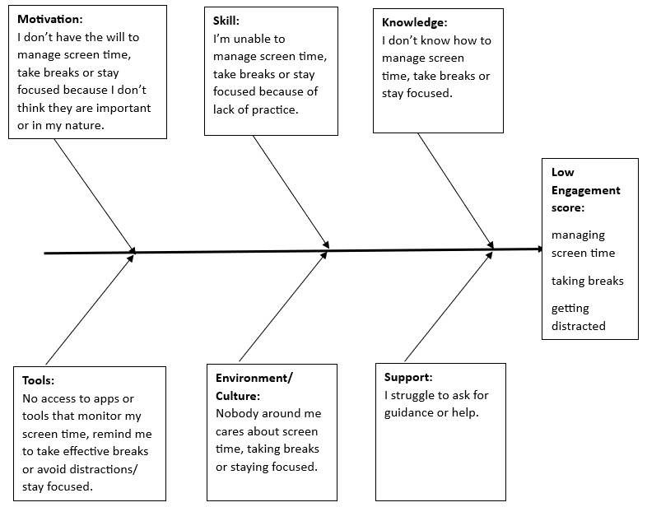
Identifying the Root Cause
To understand why a PERMA domain scored low, you need to analyse what contributes to that result. A helpful tool for this is the Fishbone (Ishikawa) Diagram.
It helps you:
• Identify all possible factors behind a problem
• Group those factors into categories
• Understand how different causes connect
• Move toward a clear root cause

Slide 11
What a Fishbone Diagram Shows
Example shown: Engagement domain
Low scores related to:
• Screen time management
• Taking breaks
• Distractions
Factors identified:
• Knowledge
• Skills
• Motivation
• Tools / Resources
• Environment / Culture
• Support
Each factor contains specific causes that influence engagement.

Slide 12
Customising Your Fishbone Diagram
When creating your diagram:
Keep only what applies to you
Your factors may differ
You can add or remove categories
Include only causes that influence your low score
Example
If you already know tools and strategies for managing screen time, remove
Knowledge as a factor.
Your challenge might instead relate to Motivation, Environment, or Support.
A tailored diagram gives a clearer picture of what is truly causing the problem and where to focus your improvement.
Notes:
Introduce the key idea (10–15 seconds)
“Now let’s look at how to customise your fishbone diagram so it truly reflects your situation. The goal is not to copy the example — it’s to create a diagram that matches your real context.”
2. Emphasise relevance (10 seconds)
“Every teacher’s digital habits, school environment, and pressure points are different. So your diagram needs to be personalised.”
3. Explain what to include (15 seconds)
“Keep only the factors that genuinely influence your low score — for example, motivation, environment, or support. Remove anything that isn’t actually part of the problem.”
4. Give a concrete example (15–20 seconds)
“Let’s say your low Engagement score isn’t because you lack knowledge — you know the tools, you know the strategies. In that case, you don’t need ‘Knowledge’ in your diagram. The real issue might be motivation, interruptions, or limited support.”
5. Reinforce the benefit (10 seconds)
“A focused, accurate diagram makes the root cause much easier to identify — and your action plan later becomes far more effective.”
6. Invite reflection or response (optional, 15 seconds)
Ask participants:
“Which factors do you already know aren’t relevant to your low-scoring domain?”
or
“Is there a factor you suspect is driving your low score?”

Slide 13
Steps of Root Cause Analysis
1. Draw the main bone
• Label it with your prioritised PERMA domain.
2. Add branch bones
• Add one branch for each factor contributing to the issue (e.g., knowledge, skills, motivation, tools, environment, support).
• Label each branch clearly.
3. Add causes
• Under each factor, list all specific causes.
• Include as many as are relevant.
4. Identify the root cause
• Look for the factor that most other causes depend on.
• This factor becomes your root cause.
Notes:
Explain the purpose
“These steps guide you from a list of possible causes to the one that truly drives the issue.”
Demonstrate visually
Point to each part of a fishbone diagram while explaining the steps.
Give a simple example
“For Engagement, you might list ‘interruptions,’ ‘overscheduling,’ ‘lack of break routines,’ etc.”
Highlight the key step
“When choosing the root cause, pick the factor that influences most of the others.”
Prepare them for the next activity
“This analysis becomes the foundation for your SMART goal and action plan.”

Slide 14
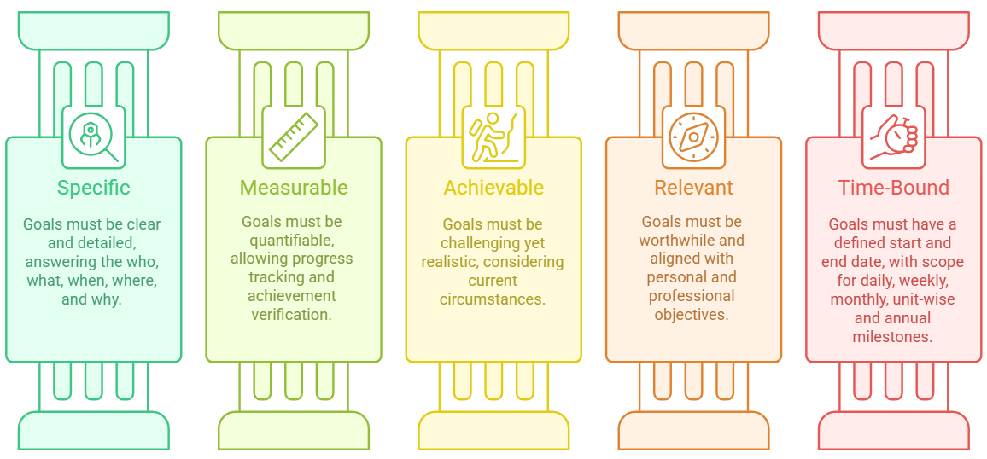
Setting Goals the SMART Way
Why SMART goals?
SMART goals give clarity and direction, so your improvement efforts have a clear target.
SMART =
• Specific
• Measurable
• Achievable
• Relevant
• Time-bound
Notes:
Explain the purpose
“These steps guide you from a list of possible causes to the one that truly drives the issue.”
Demonstrate visually
Point to each part of a fishbone diagram while explaining the steps.
Give a simple example
“For Engagement, you might list ‘interruptions,’ ‘overscheduling,’ ‘lack of break routines,’ etc.”
Highlight the key step
“When choosing the root cause, pick the factor that influences most of the others.”
Prepare them for the next activity
“This analysis becomes the foundation for your SMART goal and action plan.”

Slide 15
SMART Goal Examples (PERMA Domains)
Positive Emotions
By the end of this term, I will use Kahoot confidently to create one quiz per week to make lessons more engaging.
Engagement
Within two months, I will keep my daily screen time below 6 hours and aim for a 4-hour average to reduce screen fatigue.
Relationships
By the end of the year, I will publish a blog on our school blogspot about my gamification approach, including ideas, challenges, and successes, and acknowledge the colleagues who supported me.
Meaning
At the next teacher meeting, I will run a workshop for primary Maths teachers on how digital tools support teamwork through group assignments.
Accomplishment
By the end of the year, I will learn three new digital tools that cut my lesson-planning time by 25% and help me create more engaging materials.
Notes:
Explain that these goals show how SMART criteria work in real teaching contexts.
• Point out that each goal is tied to a specific PERMA domain and is time-bound and measurable.
• Highlight that teachers should write goals that respond directly to their root cause analysis.
• Ask participants to think about which PERMA domain they might set a SMART goal for.
• Prepare them for the next step: turning their goal into an action plan.

Slide 16
From Goal to Action
You now have a SMART goal.
The next step is to design a practical plan that takes you from your current reality to your desired well-being state.
Your action plan will help you:
• Connect your goal to real actions
• Organise your steps over time
• Use your strengths to support areas of need
• Stay focused, consistent, and accountable
Notes:
This slide bridges our work so far with the next major step. At this point, you’ve identified your priority domain, analysed the causes, and set a SMART goal. The action plan is where those insights turn into daily or weekly steps you can follow. This plan is personal, realistic, and rooted in your data. It ensures that improvement is intentional and structured, not left to chance.”

Slide 17
What Is an Action Plan?
An action plan helps you turn your SMART goal into concrete steps.
It includes:
Your current reality (where you are now)
Your SMART goal (where you want to be)
Milestones spread across the timeline
Actions and strategies linked to the root cause
Plan B options to manage possible barriers
Strengths you can use to support progress
Notes:
“An action plan is simply a structured way to move from intention to action.
It is personal, realistic, and built directly on your Index results and your root cause analysis.
Milestones help you measure progress over time, and Plan B options ensure you stay on track even when challenges appear.”

Slide 18
What Your Action Plan Is Based On
Component | What It Means
Prioritised Domain | The PERMA domain with the lowest score that requires focused improvement.
Current Reality | Your present behaviours, habits, challenges, and digital well-being state.
Root Cause | The factor influencing most other causes in your fishbone analysis.
SMART Goal | A clear, specific, measurable target linked to the root cause.
Strengths | Your highest-scoring domains that can support your improvement process.

Slide 19
Milestones, Actions & Plan B
Element | Description
Milestones | Checkpoints planned backwards from your SMART goal. They help you break the journey into manageable steps.
Actions & Strategies | Specific steps based on your root cause and secondary causes. They must be realistic and measurable.
Plan B Options | Alternative strategies to use when barriers appear. They ensure you stay on track even when challenges occur.

Slide 20
Example: Action Plan Foundations
Element | Details (Case Study)
Prioritised Domains | Engagement, Relationships
Strong Domains | Positive Emotion, Infrastructure, Culture
Current Reality | • Average 6 hrs/day screen time • Sometimes exceeds 8 hrs/day
SMART Goal | In two months, screen time will not exceed 6 hrs/day and will average around 4 hrs/day to reduce screen fatigue.
Root Cause | “I struggle to ask for guidance or help.”

Slide 21
Why Some Factors Are Not Included
In this example, certain factors do not appear in the fishbone diagram because they are not contributing to the low Engagement score.
Tools / Infrastructure
The school provides all necessary digital tools. Access, availability, and functionality are not barriers.
Environment / Culture
The school has a positive digital culture. Teachers are encouraged to use digital tools, and the environment supports healthy digital practices.
Positive Emotion
The teacher feels positive about digital tools used for teaching.
However, this positive feeling does not extend to tools that manage screen time, breaks, or focus.
For this reason, Motivation still remains a relevant factor.
Root Cause Highlight
“I struggle to ask for guidance or help.”
This factor influences several others, which is why it emerges as the root cause.

Slide 22
From Example to Your Own Plan
You have now seen how an action plan is built using a real case.
The next step is to create your own personalised action plan, based on:
• Your prioritised domain
• Your strengths
• Your root cause
• Your SMART goal
Let’s walk through the steps you will follow.

Slide 23
Steps to Create Your Action Plan
Identify your prioritised domain and your strong domains.
Complete a root cause analysis with the fishbone diagram.
Set a SMART goal for the prioritised domain.
Plan milestones by working backwards from your final goal.
Determine actions driven by the root cause and secondary causes.
Add Plan B strategies to handle possible barriers.

Slide 24
Assessment Questions
Question | Options
Q1. What is the expansion of the acronym SMART in the context of SMART goals? | • Standard, Measurable, Aligned, Rigorous, Tangible• Specific, Measurable, Accurate, Rigorous, Time-bound• Specific, Measurable, Achievable, Relevant, Time-bound
Q2. Which of the following is a SMART goal for gamification? | • I will try to make my lessons more fun by using different types of games and challenges throughout the year.• I will design and implement a points-based reward system in my science classes within the next two months to increase student participation by 20%.• I will use online quizzes and activities whenever I have time to make learning more enjoyable for my students.
Q3. Which principle best reflects the action plan development process? | • Focus primarily on the weakest domain and direct all resources to it.• Prioritise the weakest domain but also consider how strengths from top-scoring domains can support improvement.• Prioritise the strongest domain, as improvements there lead to better results across other domains.
Q4. Which approach best aligns with selecting actions for the action plan? | • Identify actions mainly based on the root cause of the current state, while also considering other influences.• Focus on actions that can be implemented quickly to build momentum.• Choose actions that build on the strengths of the top-scoring domains.
Notes:
Read each question and all options aloud before showing the answer. Give participants a moment to choose their response and invite one or two people to explain their thinking. Keep the pace steady and encourage short contributions. After the discussion, reveal the correct answer and explain why it fits the method you covered in the module. Repeat the same process for all four questions so participants stay engaged and understand how SMART goals, prioritised domains, strengths, and root cause analysis connect to the action plan.

Slide 25
Assessment
Q1. What does SMART stand for?
• Standard, Measurable, Aligned, Rigorous, Tangible
• Specific, Measurable, Accurate, Rigorous, Time-bound
• Specific, Measurable, Achievable, Relevant, Time-bound ✔
Feedback:
Correct: SMART = Specific, Measurable, Achievable, Relevant, Time-bound.
Incorrect: Other options include elements not part of the SMART framework.

Slide 26
Assessment
Q2. Which is a SMART goal for gamification?
• “I will try to make my lessons more fun using games.”
• “I will design and implement a points-based reward system in my science classes within two months to increase student participation by 20%.” ✔
• “I will use online quizzes whenever I have time.”
Feedback:
Correct: Specific, measurable, relevant, time-bound.

Slide 27
Assessment
Q3. What reflects a key principle of the action plan process?
• Focus only on the weakest domain.
• Prioritise the weakest domain but also use your strengths to support improvement. ✔
• Prioritise the strongest domain first.
Feedback:
Correct: The action plan uses root cause analysis and strengths.

Slide 28
Assessment
Q4. Which approach aligns with the process?
• Base actions mainly on the root cause, considering other influences. ✔
• Focus only on quick wins.
• Build actions only on strong domains.
Feedback:
Correct: Root cause drives meaningful change.

Slide 29
Moving Forward
You now have the tools to analyse your digital well-being, identify your priorities, and build a personalised action plan.
The next step is to ensure your plan stays relevant and effective over time.
In Unit 2.2, we focus on continuous improvement through self-reflection — how to track your progress, refine your actions, and support your digital well-being throughout the school term.

Slide 30
Unit 2.2. Continuous Improvement Through Self-reflection for Teacher Digital Well-being

Slide 31
Introduction
In this unit, you will learn how to use self-reflection to track your digital well-being.
You will work with a reflection log to review your progress, adjust your action plan, and support your personal and professional growth throughout the school term.

Slide 32
Icebreaker Discussion
Let’s begin with a short reflection:
• What does reflective practice mean to you in your daily work?
• When do you usually reflect on your teaching?
• What helps you reflect, and what makes it difficult?

Slide 33
Why Reflect?
Redefine your professional identity: Reflection helps you clarify your abilities, beliefs, and attitudes (Naseem et al., 2023)
Improve your teaching in real time: Reflection-in-action allows you to adjust based on student responses and learning progress (Purnama et al., 2025)
Innovate and adapt: Reflective teachers are more creative and responsive to classroom challenges (Jaeger, 2013; Purnama et al., 2025)
Build stronger relationships: Teachers who reflect regularly tend to be more attuned to students’ needs and foster deeper connections (Jaeger, 2013)
Create a learning community: Sharing reflections with peers strengthens collaboration and support (Purnama et al., 2025).
Notes:
Before we move deeper into reflection practices, let’s look at why reflection matters.
In the previous slide, you started thinking about what reflection means to you personally. Now we connect that to the evidence about how reflection supports teachers.
This slide highlights the key reasons reflection is essential.
Explain that reflection is not an extra task — it’s a way to improve your teaching in real time, understand your reactions, and strengthen relationships with students.
You can remind participants that reflection becomes even more important when technology is involved, because digital tools affect emotions, focus, and classroom dynamics.

Slide 34
Reflection for Digital Well-being
Digital tools are essential—but their overuse can lead to negative effects. Reflecting on your tech use helps you:
Recognize unhealthy patterns (e.g., excessive screen time, constant notifications)
Reconnect with your teaching purpose
Make intentional decisions about how and when to use technology
Activity: How to make reflection work in practice
Can you think of a moment recently when reflection helped you improve or adapt?
What makes reflection difficult in your current schedule?
Is it time, mindset, lack of tools, or something else?
Share ideas on how to make reflection practical and doable in busy schedules.
Encourage sharing of practical tips and strategies that have worked (e.g. apps, diary practice, prompts)
Notes:
On the previous slide, we looked at why reflection matters for teachers in general and how it supports creativity, responsiveness, and stronger relationships in the classroom. These benefits are especially important in a digital environment, where our tools and habits shape our daily experience.
Now we move into the next slide, which focuses specifically on digital well-being. Digital tools help us teach, communicate, and organise our work, but they can also create stress, overload, and constant pressure. This is why we need reflection — not just on our teaching, but also on our technology use.

Slide 35
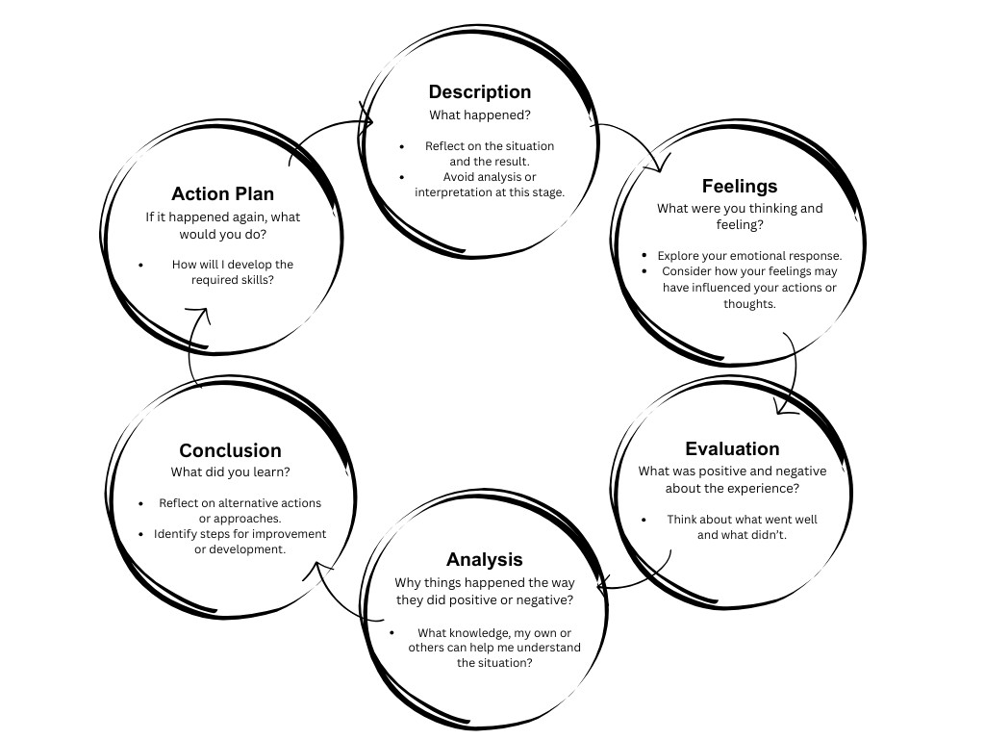
Go Beyond Surface-Level Thinking
This module challenges you to move past quick observations and engage in higher-order reflection—thinking deeply about your practice, your students, and your digital environment
Gibbs' Cycle in the reflection process
Gibbs’ Reflective cycle (Gibbs, 1988) is a structured approach to reflect on your experiences and follow up with actionable conclusions. The cycle encourages a deep and systematic approach to reflection by guiding through six stages: description, feelings, evaluation, analysis, conclusion and action plan.
Notes:
Before we move on, it’s important to highlight that effective reflection goes deeper than simply noticing what happened. To truly support your digital well-being, you need a structured way to understand your experiences, your teaching, and your digital habits in more depth. This brings us to higher-order reflection and to a model that will guide you through this process.

Slide 36
Purpose of the Upcoming Cases
The next section presents a set of examples that demonstrate how Gibbs’ Reflective Cycle is applied in practice.
Each case illustrates a different aspect of teacher digital well-being and shows how structured reflection can lead to clearer understanding and more effective actions.
These cases will support you in developing your own reflective practice later in this unit.

Slide 37
Case: Positive Emotion
Stage | Content
Description | Long digital hours leave you mentally and physically exhausted.
Feelings | You feel drained, irritable, and less motivated.
Evaluation | Digital tools help you stay organised, but constant screen use hurts your energy.
Analysis | You rarely take breaks and often work late. Research shows breaks improve emotional well-being.
Conclusion | You need clearer boundaries and short breaks during digital work.
Action Plan | Use a timer for 5-minute breaks every 45 minutes. Set a daily “digital detox” hour. Track energy weekly.

Slide 38
Case: Engagement (Improving Focus)
Stage | Content
Description | Notifications and digital distractions break your focus during lesson planning.
Feelings | You feel frustrated and scattered.
Evaluation | Your productivity and sense of accomplishment drop.
Analysis | Multitasking and interruptions harm engagement. Focused work improves performance.
Conclusion | You need a distraction-free environment and planned focus blocks.
Action Plan | Activate focus mode. Schedule uninterrupted planning time. Reflect monthly on engagement.

Slide 39
Case: Accomplishment (Celebrating Small Wins)
Stage | Content
Description | A simplified digital dashboard improves lesson flow.
Feelings | You feel proud and more confident using digital tools.
Evaluation | Focus and student engagement improved, though setup took time.
Analysis | Small, intentional changes drive real progress.
Conclusion | You should notice and celebrate small wins more often.
Action Plan | Record small wins in the log. Share one digital well-being tip each term with your team.

Slide 40
Case: External Factors (Infrastructure Constraints)
Stage | Content
Description | A digital activity failed due to weak Wi-Fi and unequal device access.
Feelings | You felt frustrated and helpless.
Evaluation | The activity was strong, but infrastructure and equity issues got in the way.
Analysis | Digital well-being is shaped by access, policy, and support, not just habits.
Conclusion | You need context-aware planning and backup options.
Action Plan | Prepare low-tech alternatives. Survey access levels. Advocate for better infrastructure. Track barriers in the log.

Slide 41
Activity
Write your own reflection case according to a goal in your Personalised Action Plan created in Unit 2.1
This self-reflection log is a practical tool for tracking your digital well-being journey over time, complementing the Personalised Action Plan. It supports personal accountability and reflection to update your action plan goals to keep them progressing. Use a self-reflection log to document your experiences and reflections on a regular basis.
Instructions
Use the Self-reflection Log monthly or quarterly to reflect on your progress.
Identify what worked well, and note any challenges you encountered and what actions to take to keep on track.
Suggest adjustments based on your reflections to Unit 2.1 Personalised Action Plan.
Share insights with peers or mentors to foster collaborative learning and the sharing of good practices.
This tool helps ensure your digital well-being strategies remain responsive, relevant, and effective throughout the academic year.
Notes:
Let’s wrap up Unit 2.2. The self-reflection log helps you track your progress, recognise what works, and adjust your action plan when needed. Using it regularly keeps your digital well-being on track throughout the school term.
We will now move to Unit 2.3, where the focus shifts from your own digital well-being to your students’. In this next unit, you’ll learn how digital environments affect students and how to use the PERMA Digital Well-being Index for Students to understand their needs and habits.

Slide 42
Unit 2.3 Understanding Students’ Digital Well-being

Slide 43
Introduction
In this unit, you will explore how digital environments influence students’ well-being.
You will work with the PERMA Digital Well-being Index for Students to identify key needs and adapt assessment strategies for different age groups.
We will introduce:
• How to use the student index
• A Classroom Observation tool to understand students’ digital behaviours
• Guiding questions that support discussion about students’ digital habits and well-being

Slide 44
Using the PERMA Digital Well-being Index for Students
The PERMA Digital Well-being Index for Students helps identify strengths and areas for growth across the PERMA dimensions. It can be used at the start, middle, and end of a term to monitor progress.
How to use the index:
• Use it as a discussion tool, not for grading
• Encourage students to reflect on their scores and set personal goals
• Combine results with observations and conversations for a fuller picture
Score Range | Meaning | What to Do
4–5 (High) | Strong digital well-being practices | Encourage continuation; invite students to share helpful habits
3 (Moderate) | Some areas need attention | Offer targeted support or small interventions
1–2 (Low) | Clear risks or gaps in digital well-being | Prioritise for planning, guidance, and additional support
Notes:
This slide explains how to work with the student version of the PERMA Digital Well-being Index.
Emphasise that the index is a reflective tool, not a grading tool. It helps students think about their digital habits and gives you a clearer picture of their digital well-being across the term.
Encourage teachers to talk with students about their scores and support them in setting simple, personal goals. Highlight that the index works best when combined with real classroom observations and short conversations with students.
Explain how to read the scores:
High scores show strong habits, mid scores show areas to strengthen, and low scores point to risks that may need attention. This scoring helps teachers prioritise support and plan next steps.”

Slide 45
Using the Index to Start Conversations
Use the Index items to open dialogue about how students see their digital well-being.
Create a safe, non-judgmental space for reflection and sharing.
You may use tools like Miro or Padlet for group or anonymous input.
You can also use simple prompts linked to the PERMA Digital Well-being domains to guide discussion.
The main goal is to help students build awareness of their digital habits and how these habits affect their well-being.
Notes:
Explain that the value of the index goes beyond the scores. It helps start meaningful conversations with students. Encourage teachers to create a space where students feel safe to share their experiences without fear of judgment.
Mention that digital tools like Miro and Padlet can make sharing easier, especially for students who prefer to contribute anonymously. Highlight that conversation prompts linked to PERMA domains can support deeper reflection.
Finish by stressing that the main purpose is awareness. When students recognise how their digital habits affect their mood, focus, and relationships, they are more likely to make healthier choices.”

Slide 46
Reflection Activity: Spotting Digital Well-being in Practice
Choose one or more prompts to reflect on:
• What patterns do I notice in my students’ digital behaviour?
• Which students seem most affected by digital tools?
• How do my teaching strategies impact their digital well-being?
• Which classroom routines help students manage tech use?
• How do I model healthy digital habits?
Next step:
Identify one small change you can make to support student digital well-being.
Write it down and keep it for your Classroom Compass activity.
Notes:
“Invite teachers to choose one prompt and reflect individually. In in-person sessions, move them into pairs or small groups. Encourage them to think of specific students and real moments from their lessons. End by asking each person to choose one small, practical change they can start this week. This will feed into the Classroom Compass they will co-create with students later.”

Slide 47
Student Digital Well-being Assessment Techniques
Observation
• Use to assess real-time behaviour.
• Look for distraction, fatigue, frustration. Use a checklist.
Self-Assessment
• Use to help students reflect.
• Try surveys, journals, or exit tickets.
Peer Feedback
• Use during group work.
• Provide sentence starters for constructive feedback.
Digital Check-ins
• Use for quick insights.
• Ask simple questions using emojis, traffic lights, or polls.

Slide 48
Matching Goals With Assessment Methods
Goal | Best Methods
Identify classroom-wide patterns | Observation, Digital Check-ins
Promote student self-awareness | Self-assessment, Check-ins
Support collaboration | Peer Feedback
Track individual progress | Discussions, Self-Assessment
Foster a reflective classroom culture | A mix of all methods over time
Notes:
Explain that no single method gives the full picture. Encourage teachers to combine approaches depending on the goal. Emphasise that choosing the right method helps them understand digital habits more accurately and respond with better strategies.

Slide 49
From Assessment to Dialogue
To understand students’ digital well-being more deeply, you also need to:
• Create space for open discussion
• Use simple prompts that help students express their experiences
• Build a classroom environment where they feel safe to share
The next slides focus on conversation starters and psychological safety.

Slide 50
Conversation Starters for Digital Well-being
Use these prompts to support open, safe discussions:
• What helps you feel good online?
• What makes digital learning easier or harder for you?
• When does technology help you connect? When does it get in the way?
• What digital habits make you feel stressed or tired?
• What digital habits make you feel proud or confident?

Slide 51
Creating Psychological Safety
A safe classroom encourages honest conversations about digital well-being.
Support this by:
• Setting clear expectations for respect
• Actively listening without judgment
• Modelling openness as an educator
• Using structured dialogue strategies (e.g., think–pair–share, restorative circles)

Slide 52
Activity: Planning a Digital Assessment Activity
In this activity, you will design a simple digital assessment for your class. Use the examples from the previous slides to guide your choices.
Think about:
• What you want to understand about your students’ digital well-being
• Which method fits best (observation, check-in, self-assessment, peer feedback)
• How you will use the results to support classroom routines

Slide 53
Conversation Starters by PERMA Domain
Positive Emotions
Prompt | Purpose
“What made you feel good or bad online today?” | Build emotional awareness
“What negative effects can too much screen time have?” | Discuss emotional impact
“What helped you stay focused today?” | Identify supportive habits
“What distracted you today?” | Explore barriers
“How long did you feel focused or distracted?” | Strengthen self-monitoring
“What are you grateful for today?” | Promote positive reflection

Slide 54
Conversation Starters by PERMA Domain
Engagement
Prompt | Purpose
“What helps you stay focused when using technology?” | Identify focus strategies
“Do you notice when you start scrolling without thinking?” | Build awareness
“How do you feel after multitasking online?” | Understand impact
“How do you feel when you take a screen break?” | Reinforce healthy habits
“What’s your favourite way to reset your focus?” | Share practical tools

Slide 55
Conversation Starters by PERMA Domain
Relationships
Prompt | Purpose
“How do you show respect or kindness online?” | Support positive behaviour
“Have you experienced cyberbullying? What would you do?” | Promote safety actions
“Have you misunderstood someone’s tone online?” | Build communication skills
“What’s a kind message you received?” | Highlight positive interactions
“Have you seen unfair behaviour online?” | Encourage responsible action
“What’s the difference between joking and hurting someone?” | Clarify boundaries

Slide 56
Conversation Starters by PERMA Domain
Meaning
Prompt | Purpose
“How do you want others to see you online?” | Explore digital identity
“What info is safe to share online?” | Strengthen digital boundaries
“What platforms matter most to you and why?” | Understand values
“What are you good at? How can it help others?” | Encourage prosocial use
“What have you learned online that changed you?” | Connect learning to purpose
“What digital project reflects who you are?” | Foster meaningful creation

Slide 57
Conversation Starters by PERMA Domain
Accomplisment
Prompt | Purpose
“What did you learn from this digital challenge?” | Build resilience
“What can you try next?” | Support problem-solving
“Who can you ask for help?” | Encourage help-seeking
“Which digital skill was hardest to learn?” | Reflect on effort
“What digital skill do you want to master?” | Set growth goals
“What digital task are you proud of this week?” | Celebrate progress

Slide 58
Why Use a Classroom Observation Tool?
Understanding students’ digital well-being requires more than scores or surveys.
This tool helps you see how PERMA shows up in real classroom behaviour and gives you a fuller picture of students’ digital habits.
Use it to:
• Notice emotional and behavioural cues during digital tasks
• Identify patterns linked to the five PERMA domains
• Spot early signs of digital fatigue, distraction, or stress
• Recognise positive moments of focus, connection, and achievement
• Build a more accurate understanding of students’ digital needs
This prepares you to support students better and co-create a healthy digital classroom environment.
Notes:
This slide explains why we introduce the Classroom Observation Tool at this point in the training.
Up to now, we explored how to assess digital well-being using the PERMA Index for Students. This tool complements that process by helping you observe real classroom behaviour.
Students often express their digital well-being through actions, not only through self-reports. Observation helps you understand what is happening in practice: who is engaged, who is frustrated, who struggles to focus, and who thrives when using digital tools.
This also connects directly to the PERMA domains. In the observations you will notice emotional cues for Positive Emotions, signs of focus or distraction for Engagement, interaction patterns for Relationships, and indicators of Meaning and Accomplishment during digital tasks.
The goal is to give you a fuller picture of your students’ digital habits so you can personalise your teaching strategies and prepare more effectively for creating the Classroom Compass later in the unit.

Slide 59
Classroom Observation Tool (PERMA-Aligned)
Use this tool to notice how students show digital well-being in real classroom situations.
PERMA Area | What to Look For | Examples in Practice
Positive Emotions | Signs of comfort, enjoyment, or frustration with digital tasks | Smiling, enthusiasm, stress signals, irritability
Engagement | Focus, absorption, distraction patterns | Deep concentration, mind-wandering, constant switching
Relationships | Online and in-class interaction quality | Supportive teamwork, exclusion, unkind messaging
Meaning | Purposeful use of digital tools | Students linking tech use to learning goals or values
Accomplishment | Progress, confidence, or struggle with tasks | Pride in completing work, giving up quickly, seeking help
External Factors | Environmental or resource-based constraints | Wi-Fi issues, device access, classroom setup
Notes:
This slide helps you translate the PERMA framework into classroom observation.
Up to this point, we focused on the Index. Now, we complement it with real behaviour.
Students often show their level of digital well-being through small actions: how they focus, how they interact, how confident they feel, or how easily they become frustrated.
The table shows what to pay attention to in each PERMA area.
• For Positive Emotions, notice signs of enjoyment or stress during digital tasks.
• For Engagement, look at whether students remain focused or switch constantly between tabs or apps.
• For Relationships, observe how they collaborate and communicate—both online and offline.
• For Meaning, check whether students understand why they are using a tool, not just how.
• For Accomplishment, look for evidence of progress, persistence, or confidence with digital tools.
• And finally, external factors such as Wi-Fi reliability and device access also shape digital well-being.
These observations will help you understand patterns, tailor your support, and prepare for creating the Classroom Compass with your students later.

Slide 60
Unit 2.4 Improving the Digital Well-being of Students

Slide 61
Introduction
In this unit, we will:
Address the key digital well-being issues identified in the previous module
Explore activities and tools that help teachers build healthier digital boundaries
Understand why digital boundaries matter for both teachers and students
Learn practical strategies to support boundary-setting in everyday classroom life
Introduce the Digital Well-being Classroom Compass as a collaborative tool
Use the Compass to guide discussions on digital habits and create a supportive climate
Integrate PERMA-based interventions to help students develop sustained, healthy digital behaviours

Slide 62
What Are Digital Boundaries?
Personal and professional limits that guide how, when, and why we use technology
Help regulate communication, device use, and online interactions
Extend emotional and psychological boundaries into digital spaces
Shape our availability, acceptable digital behaviour, and attention management
For teachers: include managing after-hours messages, digital workload, and professional–personal overlal
Aim is intentional use of technology, not avoidance
Support healthy engagement without harming focus, privacy, or mental health
Notes:
This slide introduces the idea of digital boundaries and why they matter.
I want you to think of digital boundaries as the limits we set to protect our time, attention, and emotional space when using technology.
For teachers, these boundaries are especially important because the digital world blurs personal and professional lines. Messages arrive outside working hours, marking can continue late at night, and online platforms make us feel constantly available.
The key message here is that boundaries are not about using technology less, but about using it intentionally.
They help us stay in control instead of reacting to every notification, message, or digital demand.
These boundaries support healthy engagement without harming focus, privacy, or mental health.

Slide 63
Why Do We Need Digital Boundaries?
Reduce digital overload and prevent burnout
Protect mental health and lower anxiety linked to constant connectivity
Improve focus by managing notifications and multitasking
Strengthen real-world relationships through present, mindful interaction
Support sustainable work–life balance for teachers
Model healthy digital habits for students
Notes:
This slide explains the reasons behind setting digital boundaries.
Constant connectivity can quickly lead to overload. Without limits, it becomes harder to disconnect, rest, and stay productive.
Clear boundaries also protect mental health. Research shows that digital overload increases stress, anxiety, and emotional fatigue.
By managing our device use, we can improve our focus, maintain presence with others, and strengthen our relationships.
For teachers, boundaries also model healthy digital habits for students. When you manage your own digital behaviour intentionally, students learn to do the same.
This sets the stage for creating a healthier classroom culture and supports the next tools we will introduce

Slide 64
Strategies for Supporting Students’ Digital Boundaries
Teachers act as digital role models
Students mirror adults’ online habits
Mindful tech use by teachers sets clear expectations
Healthy boundaries reduce stress linked to digital risks (O’Reilly et al., 2018)
Balanced practices help students manage attention, emotions, and online behaviour

Slide 65
Activity 1: Reflecting on Your Own Digital Well-being
Step 1 — Individual reflection (5 min)
• When do I feel most digitally drained?
• What digital communication stresses me most?
• How do I separate personal vs. professional digital spaces?
• What one habit could I change to feel more balanced?
Step 2 — Group reflection (5 min)
• How does the school culture shape digital boundaries?
• What are the unspoken expectations for digital availability?
• Where are digital boundaries hardest to maintain?
• How can we support each other as a team?
• What boundaries should we model for students?
Step 3 — Group conclusions
• Identify 2–3 recommendations for the school leadership
• Focus on staff well-being and boundary-supportive practices
Notes:
This section highlights that teachers influence students’ digital habits by the way they manage their own digital behaviour. Students often copy what they see. If teachers maintain limits around availability, manage notifications, and keep a balance between work and personal time, students learn healthier patterns.
The activity is designed to help teachers understand their own digital habits first.
You start with short individual reflection, then discuss in groups, and end by forming recommendations that could help the whole school.
The aim is simple: teachers who feel balanced are better able to support students’ digital boundaries. This activity prepares you to think about changes you can make personally, and changes the school can make collectively.

Slide 66
Activity 2: Developing Digital Boundaries for Students
Purpose
• Shift focus from teacher habits to students’ digital boundaries
• Support students in building healthy, mindful, and responsible tech use
• Co-create simple, usable classroom guidelines
How the Activity Works
• Form small groups (3–5 participants)
• Discuss challenges students face online and in class
• Identify practical strategies for healthier digital habits
• Create 3–5 classroom digital boundary guidelines
• Present ideas to the group
Guiding Questions
• When does tech affect students’ mood, sleep, or concentration?
• What routines help students manage devices better?
• How can families support digital habits at home?
• What school rules or expectations influence boundaries?
• How can we model balanced digital use ourselves?
Example Outputs
• “No devices in the first 10 minutes of class”
• “Notifications off during study blocks”
• “Discuss before responding to online messages”
Notes:
This activity builds directly on the previous reflection. First, remind participants that students mirror what adults model. Now we turn their attention to learners and ask them to think about real challenges: distraction, late-night screen time, pressure from messages, social media stress.
Invite them to work in small groups and come up with realistic, classroom-friendly digital boundaries. Encourage them to think both inside and outside school hours. If needed, show the example outputs to help groups get started, but keep their ideas grounded in their own school context.
When groups present, highlight common themes—focus, healthy routines, notification management, respectful communication—and link back to the school culture discussion from before.

Slide 67
Classroom Compass for Digital Well-being
What it is
• A co-design tool for creating a classroom that supports digital well-being
• Based on the PERMA Digital Well-being Framework
• Turns Student Index results into concrete habits, routines, and actions
How to Use It
• Add PERMA scores in the “Average Rating” column
• Reflect and identify domains that need support
• Set SMART goals with your students
• Choose strategies that fit your classroom
• Agree on a timeline and indicators of progress
• Treat it as a living document and update it during the term
Piloting Activities
• Select one activity from the collection
• Role-play it in small groups
• Note what works, what doesn’t, and what needs adapting
• Discuss adjustments and consider student age, needs, and school context
Notes:
Explain that the Classroom Compass is the bridge between student assessment and practical classroom change. It helps teachers move from awareness to action. Emphasize its collaborative nature: students help shape the goals and habits. This keeps the plan meaningful and realistic.
Walk participants through the steps: scoring, prioritising domains, setting SMART goals, selecting strategies, and monitoring progress. Encourage them to see the Compass as a flexible guide rather than a fixed document.
For piloting, remind them to experiment with one activity first. Role-play helps teachers see how students might react, what support they will need, and how to tailor the activity to their context. After piloting, groups share observations and refine their ideas before implementing them with students.

Slide 68
Activities Collection & Piloting
Now that you know how to use the Classroom Compass, the next step is to test practical activities that support each PERMA domain.
• These activities help you turn goals into daily habits in your classroom.
Activities Collection
• Includes activities for common digital well-being challenges
• Organised by PERMA domains
• Builds student self-awareness and ownership
Piloting the Activities
• Choose one activity from the module
• Role-play it in a small group
• One person acts as the teacher; others as students
What to Observe
• What works well
• What challenges emerge
• What needs adapting for your classroom
• What changes improve clarity or engagement
Next Step
• Discuss your observations as a group
• Adapt the activity for your students’ age, needs, and digital habits
Notes:
Explain that this step helps teachers move from planning to real practice. Emphasize that piloting is low-risk: it lets teachers test an activity before using it with students. Encourage them to notice small details during the role-play, such as timing, clarity of instructions, student reactions, and how realistic the activity feels.
Highlight that group discussion strengthens the process. When teachers compare their experiences, they refine the activity and make it more suitable for their classroom context. Encourage participants to think about age differences, digital access, and typical challenges their students face. Remind them that these activities are flexible and can be customised to fit their routines.

Slide 69
Implement PERMA-Based Activities
Before we move into the activities…
• You now have your Student Digital Well-being Index results
• You’ve reflected on key needs in your classroom
• You’ve identified domains that require attention
This next section shows you how to turn those insights into action
• You’ll work with targeted activities linked to each PERMA domain
• You’ll choose the ones that fit your students’ needs
• You’ll learn how to pilot, adapt, and refine them for real classroom use
Goal
• Support students through practical, ready-to-use strategies
• Strengthen digital habits with structured, evidence-based exercises
• Build consistency across lessons and routines

Slide 70
How This Section Works
In the next slides, you will:
• Review activities grouped under each PERMA domain
• See options for primary and lower-secondary students
• Identify which activities match your classroom priorities
• Learn how to test (pilot) an activity safely before using it with students
Your task during this section:
• Start with one domain only
• Pick 1–2 activities to try
• Note what works, what doesn’t, and what to adapt
• Think of concrete next steps for your Classroom Compass

Slide 71
POSITIVE EMOTIONS — Activity Overview Table
Activity | Purpose | Primary Students | Lower Secondary Students
Emotion Check-Ins with Emoji Maps | Help students notice and express feelings during digital tasks | Emoji map or thermometer; place stickers before/during/after tasks | Digital mood tracker; reflect on triggers and strategies
Purpose Framing: “Why Am I Using This Tool?” | Connect digital use with meaningful learning goals | Ask “Why are we using this tool?” and revisit after the task | Short written reflections; compare which tools help or distract
Gamified Focus Challenge | Make focus and effort enjoyable; build persistence | “Focus Star” chart; celebrate effort weekly | Class leaderboard; peer nominations for focused work
Reflective Feedback Loop | Evaluate emotional experience and improve digital tasks | Quick emoji survey after tasks | Short form on enjoyment, challenges, and improvements

Slide 72
RELATIONSHIPS — Activity Overview Table
Activity | Purpose | Primary Students | Lower Secondary Students
Digital Code of Kindness | Build norms for respectful online behaviour | Brainstorm kindness online; create class poster | Group discussions; create a Digital Citizenship Charter
Co-Regulation Partners | Support peers in emotional and focus regulation | Paired check-ins with emoji cards | Digital Accountability Buddies with pre/post reflection
Perspective-Taking Scenarios | Build empathy and responsible online communication | Story cards; discuss feelings; short skits | Discuss digital dilemmas; practise I-statements
Digital Empathy Circles | Create space to share experiences safely | Circle sharing using talking object | Small reflection groups; weekly discussions

Slide 73
MEANING — Activity Overview Table
Activity | Purpose | Primary Students | Lower Secondary Students
“Why Am I Here Online?” Reflection | Build intentional and mindful tech use | Ask purpose before/after tasks; emoji posters | Digital Intent Journal before/after each task
Connecting Learning to Life | Make digital learning personally relevant | Choose topics they care about; share findings | Research and present “Why This Matters to Me”
Digital Journaling for Reflection | Reflect on emotions and values in digital tasks | Draw/write in Digital Feelings Journal | Weekly reflection logs on positives and challenges
“Create, Don’t Consume” Projects | Shift from passive use to meaningful creation | Create posters, audio notes, class collages | Student-led micro-projects tied to values/interests

Slide 74
ACCOMPLISHMENT — Activity Overview Table
Activity | Purpose | Primary Students | Lower Secondary Students
Digital Growth Trackers | Visualise and celebrate progress | Simple skill trackers; weekly check-ins | Growth Journals with evidence of progress
Tool Explorer Sessions | Build confidence using new tools | Try 2–3 safe tools; share what they liked | Choice-based assignments; justify tool selection
Feedback for Growth | Strengthen learning through constructive feedback | “Two Stars and a Wish” | Digital peer review using structured stems
Digital Confidence Milestones | Celebrate digital achievements and effort | “Digital Champions Day”; certificates | Student showcase of achievements and growth

Slide 75
Conclusions
Conclusion — Positive Emotions
• These activities help students notice how digital tools affect their feelings.
• You guide them to understand triggers, manage frustration, and enjoy learning.
• When students recognise their emotional patterns, they make healthier choices online.
• This builds the foundation for balanced digital behaviour and calmer classroom routines.
Conclusion — Engagement
• Students learn how to stay focused, manage distractions, and work with purpose.
• Simple routines—focus cycles, one-task habits, and notification control—improve attention.
• These skills matter because they reduce digital overload and improve learning quality.
• Stronger engagement leads to more productive lessons and better use of digital tools.

Slide 76
Conclusions
Conclusion — Relationships
• These practices strengthen empathy, kindness, and responsible online behaviour.
• Students learn to communicate clearly, support peers, and manage conflict in digital spaces.
• Healthy digital relationships increase safety, belonging, and trust in hybrid learning.
• When students feel respected online, they participate more and take more positive risks.
Conclusion — Meaning
• These activities help students connect their digital use to personal goals and values.
• They learn to ask “Why am I using this tool?” before they start.
• Purposeful use reduces passive scrolling and increases motivation.
• Building meaning motivates students to use technology for growth rather than distraction.
Conclusion — Accomplishment
• These routines help students see their progress and build confidence with digital skills.
• Celebrating small wins increases motivation and strengthens resilience.
• Students learn to value improvement, not perfection.
• When students feel capable online, their digital well-being and learning outcomes rise.

Slide 77
Conclusions
Together, these activities give you practical ways to support students’ digital well-being across all PERMA domains.
You help students understand their feelings, stay focused, build healthy relationships, use technology with purpose, and recognise their progress.
This approach creates healthier digital habits, stronger learning routines, and a more supportive classroom climate.
You now have a complete toolkit to guide your students toward balanced, intentional, and confident digital use.

Slide 78
Module 2 Closing: Strengthening Digital Well-being in Schools
This module helped you:
• Understand digital boundaries for teachers and students
• Use reflection to guide healthier digital habits
• Assess student digital well-being through the PERMA framework
• Co-create classroom digital boundaries and routines
• Apply targeted PERMA-based activities across all domains
• Use the Classroom Compass to translate insights into action
By completing Unit 2.4, you now have:
• A full toolkit to identify, address, and improve digital well-being
• Strategies that support emotional, cognitive, and social development
• Practical classroom activities ready for implementation
• A foundation to create a healthier digital culture across your school
Notes:
This brings us to the end of Unit 2.4 and the full Module 2.
You’ve explored everything from teacher boundaries to student habits, classroom climate, and targeted PERMA-based strategies.
The goal was to help you feel confident in identifying digital well-being needs and applying practical tools in your own classroom.
As we move into the next module, we shift from implementation to sustainability — how to keep good practices alive and monitor their long-term impact on students.

Slide 79
https://perma-digital.eu/

