Slide 1
Module 1
Introduction to Digital Well-being: the PERMA-Digital Frameworks

Slide 2
Introduction
This module introduces the PERMA-Digital Framework, which focuses on internal factors of well-being (Positive Emotions, Engagement, Relationships, Meaning, and Accomplishment) and external influences (culture, family, curricula, policy, and infrastructure).
By the end of the module, you'll be able to understand key concepts related to well-being, recognise the PERMA model, and its connection to DigComp and LifeComp frameworks.

Slide 3
Learning objectives
Unit 1.1
Recognise and describe the key components of well-being: physical, mental, emotional, and social health and their association with digital well-being.
Identify positive and negative digital and non-digital effects on students in upper primary and early secondary education.
Unit 1.2
Recognise the five PERMA elements: Positive Emotions, Engagement, Relationships, Meaning, and Accomplishment.
Differentiate between the PERMA elements' unique contributions to overall well-being.
Unit 1.3
Identify principles of DigComp, LifeComp frameworks, and illustrate their connections to well-being.
Synthesise the three frameworks to formulate the integrated PERMA-Digital model.
Unit 1.4
Analyse aspects of PERMA in relation to DigComp and LifeComp.
Synthesise the three frameworks to formulate the integrated PERMA-Digital model.

Slide 4
Unit 1
Importance of well-being and digital well-being

Slide 5
Unit 1: Importance of well-being and digital well-being
1.1 What is “Well-being”?
Well-being is more than just the absence of stress or illness, it is a state of physical, mental, emotional, and social balance that allows you to thrive, learn, and connect meaningfully with others.
The presence of positive emotions and moods, the absence of negative emotions, satisfaction with life, fulfillment, and positive functioning.
1.2 What is “Digital Well-being”?
The connection between well-being and digital well-being emerged gradually as technology became embedded in daily life.
Traditionally, well-being referred to physical, mental, and social health, rooted in frameworks from philosophy, psychology, and public health. With the rise of personal computers, the internet, and later smartphones, researchers began noting both benefits and risks to well-being:
While technology enabled connection, learning, and self-expression, it also introduced stress, distraction, and overuse.
“The ability to use digital technology consciously, intentionally, and in a balanced way so that it supports physical, emotional, and social health, rather than detracts from it” (Vanden Abeele, 2021)
Notes:
Well-being: When your own well-being is strong, you are better equipped to support your students’ learning, creativity, and resilience.
Digital well-being: By the 2010s, concerns over social media, screen time, and gaming led to the recognition of “digital well-being” as a distinct concept with tech companies, policymakers, and educators adopting digital well-being as part of broader well-being frameworks (e.g. Google’s Digital well-being initiative and Apple’s Screen Time).

Slide 6




Unit 1: Importance of well-being and digital well-being
1.2 What is “Digital Well-being”?
Key characteristics of digital well-being include:
FIGURE: KEY CHARACTERISTICS
Balance | Safety
Manage screen time Avoid digital fatigue | Protect privacy Avoid harmful content Ensure emotional security online
Purposefulness | Empowerment
Use technology to learn, connect, and create meaning rather than passive consumption | Feel in control of digital use Develop digital citizenship

Slide 7
Unit 1: Importance of well-being and digital well-being
1.3 The necessity of digital well-being in education
Recent findings from the WHO (2025), OECD (2024), and the European Commission (2025) show that digital environments strongly influence young people’s mental health.
Rising problematic social media use, harmful content, and cyberbullying place vulnerable students at higher risk, while OECD (2024) data shows that teacher stress and workload remain high despite technological advances. These trends highlight the need for schools to guide students toward safer, more balanced digital habits and create supportive learning environments.
“A state of physical, cognitive, social, and emotional contentment that enables individuals to engage positively in all digital learning environments.”
In other words, when learners and teachers feel balanced and supported, they are more confident, motivated, and open to new learning experiences.

Slide 8
Unit 1: Importance of well-being and digital well-being
1.3 The necessity of digital well-being in education
Why does it matter?

Slide 9
Unit 1: Importance of well-being and digital well-being
1.3 The necessity of digital well-being in education
Research shows both positive and negative effects:
Positive Effects: enhanced collaboration , access to knowledge, inclusive learning opportunities, creative expression.
Negative Effects: screen fatigue, cyberbullying , reduced attention span, social comparison, disrupted sleep.
Addressing digital well-being ensures your students not only gain knowledge, but also develop healthy habits that support lifelong learning and responsible citizenship.
Notes:
Case studies across Europe highlight how structured approaches, such as integrating well-being frameworks into curricula, can reduce stress, improve peer relationships, and build resilience in digital environments (PERMA-Digital Consortium, 2025).

Slide 10
Unit 1: Importance of well-being and digital well-being
Activity 1 - Understanding Digital & Non-Digital Contexts
This activity helps you understand how digital and non-digital contexts affect well-being across four areas. After completing it yourself, you can repeat the same steps with your students to help them recognise how their daily digital habits influence how they feel, think, and behave.
Step 1
Use the table in the document “Comparing the Positive and Negative Effects on Students” to compare how digital and non-digital contexts influence students’ physical, mental, emotional and social well-being.
Step 2
Read the examples in each column and think about how these situations appear in your own classroom.
Step 3
Add one example from your teaching experience in any row that feels relevant.
Take a moment to think:
Which domains who the greatest risks? Which opportunities for growth stand out?
Are there any ways to minimise the negative effects of digital and non-digital contexts?
Notes:
Hand out the document “Comparing the positive and negative effects on students”
Go through the document and the steps with the educators
Facilitate their reflection process - give them time to add one example and provide the choice of sharing with the group if anyone would like to.
Be flexible to open up a discussion if everyone feels comfortable.
At the end, mention that they can do this activity with their class. Ask students to add their own examples from school and home. This helps them understand how technology affects their physical, emotional, mental and social well-being and encourages healthier choices.

Slide 11
Unit 1: Importance of well-being and digital well-being
Activity 2 - How Digital Tools Affect Students’ Well-Being
This activity helps you see how digital tools affect your students’ well-being in everyday class life.
Step 1
Look at the activity sheet handed out to you.
Step 2
Think about examples from your classroom and fill in each part of the table on your own.
Step 3
Highlight (or colour-code) which domains have the strongest positive and negative digital effects.
Step 4
Write a short paragraph in your learning journal or discussion forum post: “How can I enhance the positive effects of digital tools on students’ well-being, and reduce the negative ones?”
Notes:
Hand out the activity sheet “Topic: Comparing the Positive and Negative Effects on Students”
Facilitate their reflection process - give them time for Step 2 and 3 and provide the choice of sharing with the group if anyone would like to.
Be flexible to open up a discussion if everyone feels comfortable.

Slide 12
Unit 2
The PERMA Framework - Pillars of well-being

Slide 13
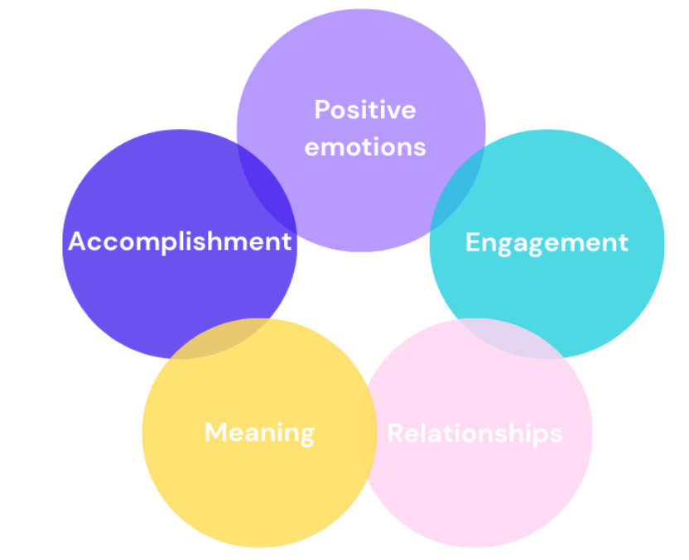
Unit 2: The PERMA Framework - Pillars of well-being
2.1 Introduction to PERMA model
Seligman's (2011) PERMA model offers a scientifically grounded framework for well-being, built on five core elements: Positive Emotions, Engagement, Relationships, Meaning, and Accomplishment.
Notes:
Ask the educators: “Before we explore each pillar of the PERMA model in detail, let’s discover how these elements work together in daily life.
As you read through them, think about moments from your own experience, inside or outside the classroom, that reflect these ideas. This reflection will help you recognise how the PERMA elements contribute to your own flourishing and how they can guide your approach to support students’ well-being.”

Slide 14
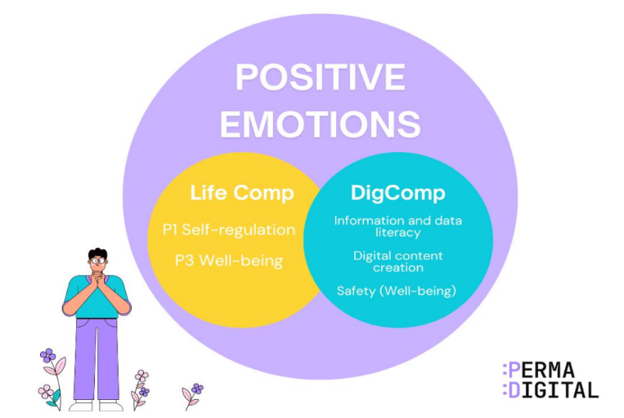
Unit 2: The PERMA Framework - Pillars of well-being
2.1 Introduction to PERMA model
P - Positive Emotions: Experiencing joy, gratitude, hope and optimism. These emotions broaden your perspective and build resilience.
Notes:
Mention these examples:
Personal: Feeling grateful when a student thanks you for helping them understand a difficult topic.
Professional: Feeling proud when your class responds enthusiastically to a new activity or lesson idea that worked well.

Slide 15
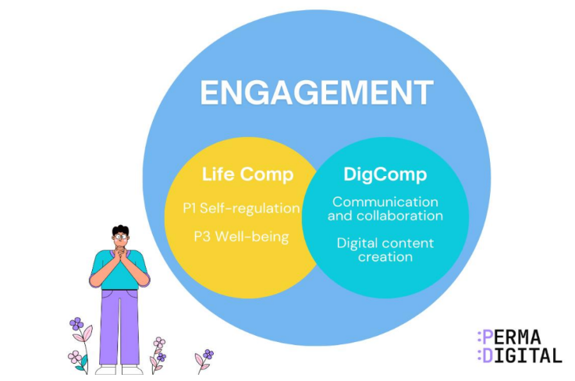
Unit 2: The PERMA Framework - Pillars of well-being
2.1 Introduction to PERMA model
E – Engagement: Being fully absorbed in meaningful activities (“flow”), where time seems to pass quickly.
Notes:
Mention these examples:
Personal: Losing yourself in preparing creative classroom materials or decorating your class for a new project.
Professional: Guiding a lively science experiment or group project where students are completely immersed and time flies.

Slide 16
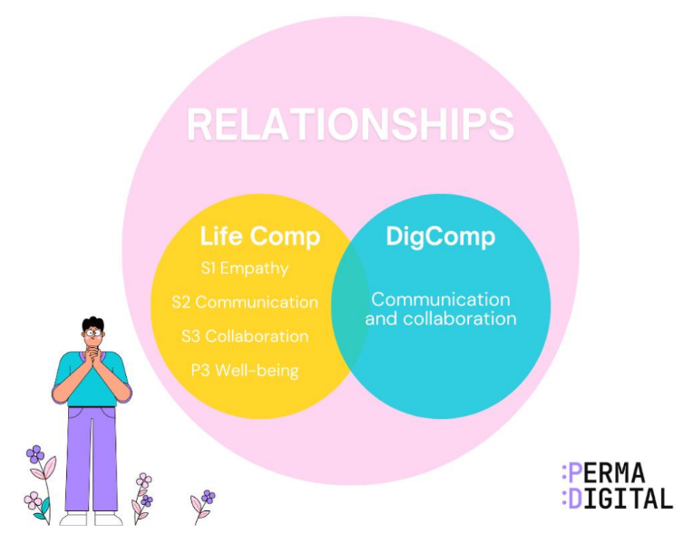
Unit 2: The PERMA Framework - Pillars of well-being
2.1 Introduction to PERMA model
R – Relationships: Building strong, supportive, and trusting connections with others.
Notes:
Mention these examples:
Personal: Sharing experiences and laughter with colleagues over a cup of coffee after a long school day.
Professional: Collaborating with a teaching partner or helping a struggling student regain confidence through encouragement.

Slide 17
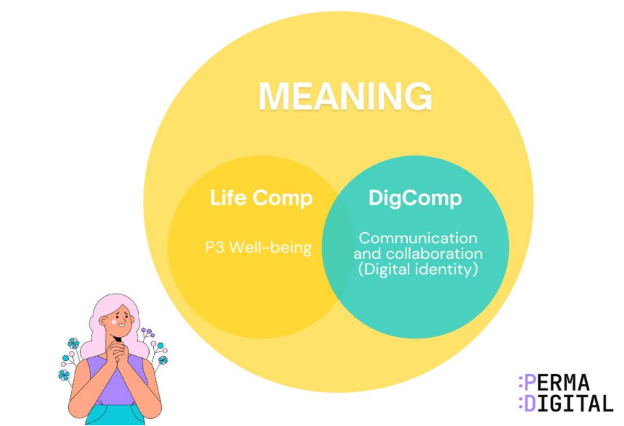
Unit 2: The PERMA Framework - Pillars of well-being
2.1 Introduction to PERMA model
M – Meaning: Having a sense of purpose, belonging, and connection to something larger than yourself.
Notes:
Mention these examples:
Personal: Volunteering for a school event or mentoring a new teacher and seeing them grow in confidence.
Professional: Recognising that your teaching helps shape students’ lives and contributes to their future success.

Slide 18
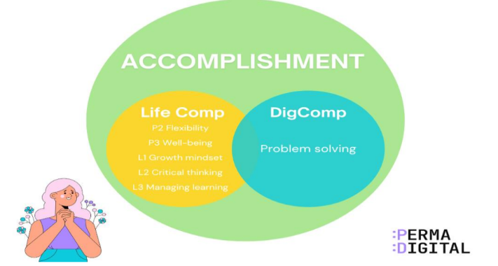
Unit 2: The PERMA Framework - Pillars of well-being
2.1 Introduction to PERMA model
A – Accomplishment: Striving for and achieving goals, which builds confidence and competence.
Notes:
Mention these examples:
Personal: Completing a professional development course or successfully balancing teaching with family responsibilities.
Professional: Seeing your students reach a learning goal, improve their behaviour, or show pride in their work because of your guidance.
As you progress through the module, you’ll see how each one connects to digital experiences and how the PERMA-Digital Framework helps you and your students flourish in both online and offline learning environments.

Slide 19
Unit 2: The PERMA Framework - Pillars of well-being
2.2 Psychological, Behavioural, and Emotional Dimensions of PERMA
P – Positive Emotions
Psychological aspect: Supports flexible thinking, resilience, and creativity.
Behavioural aspect: Acts of gratitude, noticing joyful moments, and expressing appreciation.
Emotional aspect: Joy, hope, love, and optimism that buffer stress and help recovery.
E – Engagement
Psychological aspect: Flow increases focus, intrinsic motivation, and problem-solving ability.
Behavioural aspect: Full immersion in activities such as sports, music, writing, or coding.
Emotional aspect: Energy, absorption, and deep satisfaction during challenging tasks.
R – Relationships
Psychological aspect: Connection boosts self-worth and reduces anxiety.
Behavioural aspect: Trust-building, active listening, cooperation, and regular interaction.
Emotional aspect: Belonging, security, and support that reduce loneliness.
M – Meaning
Psychological aspect: Provides direction by linking values to purpose.
Behavioural aspect: Contributing to causes, volunteering, or purposeful work.
Emotional aspect: Fulfilment, alignment with values, and pride in contributing.
A – Accomplishment
Psychological aspect: Builds self-efficacy and motivation through mastery.
Behavioural aspect: Setting goals, persisting through difficulty, and marking progress.
Emotional aspect: Confidence, pride, and motivation after achievement.
Notes:
BEFORE SHOWING THE TABLE
Before you explore how the PERMA elements show up in daily life, let’s see each one through three lenses: psychological, behavioural, and emotional.
This shall give you a clear picture of how well-being grows through your thoughts, your actions, and your emotional experiences. It will also help you see what you can apply directly in your own life and in your work with students.
Tell the educators to read through the examples for each pillar and think of ways to grow these elements in their daily routine. Use a starter question like: What cultivates positive emotions for me?
To guide their thinking, mention these: • End your day by writing three specific things that brought you joy. • Pause and savour a positive moment for at least ten seconds when it happens. • Spend a few minutes in nature, art, or inspiring stories to spark awe.
AFTER
Show the table

Slide 20
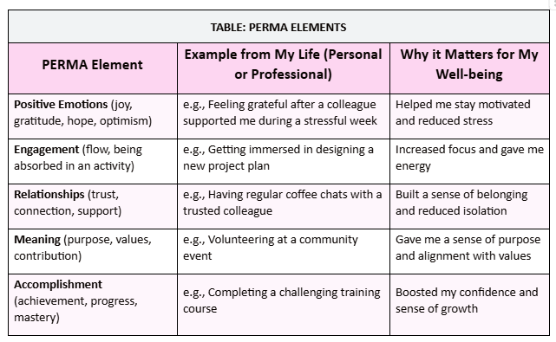
Unit 2: The PERMA Framework - Pillars of well-being
Activity - Evaluating your Experiences
Step 1
Think of your experiences:
Think about your personal and professional experiences.
For each PERMA element, provide at least one example where you experienced it.
Then explain why that experience was important for your well-being.
Step 2
Consider the following:
Which PERMA element shows up most strongly in your life right now?
Which element do you feel needs more attention, and how might you strengthen it? Why do you think that this element needs more attention?
Notes:
Hand out the activity sheet “Topic: Evaluating your Experiences”
Tell educators to use the table from the activity sheet to guide their reflection (table is also here for facilitator’s reference)

Slide 21
Unit 3
The DigComp, LifeComp Frameworks and relation to digital well-being

Slide 22

Unit 3: The DigComp, LifeComp Frameworks and relation to digital well-being
3.1 DigComp (Digital Competence) Framework
DigComp 2.0
Notes:
Watch this video as an introduction

Slide 23
Unit 3: The DigComp, LifeComp Frameworks and relation to digital well-being
3.1 DigComp (Digital Competence) Framework
The DigComp Framework, originally developed by the European Commission, provides a shared understanding of what it means to be digitally competent in today’s society.
It serves as a foundation for digital education policies across Europe. For teachers, DigComp offers a roadmap to help you and your students develop the knowledge, skills, and attitudes needed to use digital technologies critically, creatively, and safely.
Being “digitally competent” doesn’t just mean knowing how to use software or devices; it’s about using them thoughtfully and purposefully.

Slide 24
Unit 3: The DigComp, LifeComp Frameworks and relation to digital well-being
3.1 DigComp in the PERMA-Digital Model
In the PERMA-Digital model, DigComp provides the practical skills that help teachers and students use technology with confidence, balance, and responsibility, which are essential for digital well-being. It consists of five areas:
Information and Data Literacy | Searching, evaluating, and managing digital information. | 1.1 Browsing, searching and filtering data, information and digital content 1.2 Evaluating data, information and digital content 1.3 Managing data, information and digital content
Communication and Collaboration | Digital interaction, sharing, and online citizenship. | 2.1 Interacting through digital technologies 2.2 Sharing through digital technologies 2.3 Engaging in citizenship through digital technologies 2.4 Collaborating through digital technologies 2.5 Netiquette 2.6 Managing digital identity
Digital Content Creation | Developing and integrating digital content. | 3.1 Developing digital content 3.2 Integrating and re-elaborating digital content 3.3 Copyright and licences 3.4 Programming
Safety | Online security, digital well-being, and privacy protection. | 4.1 Protecting devices 4.2 Protecting personal data and privacy 4.3 Protecting health and well-being 4.4 Protecting the environment
Problem-Solving | Identifying digital needs, troubleshooting issues, and innovative use of technology. | 5.1 Solving technical problems 5.2 Identifying needs and technological responses 5.3 Creatively using digital technologies 5.4 Identifying digital competence gaps

Slide 25
Unit 3: The DigComp, LifeComp Frameworks and relation to digital well-being
3.1 DigComp in the PERMA-Digital Model
Information and Data Literacy
You are constantly helping students find, interpret, and evaluate information. This competence involves knowing how to search effectively, judge the reliability of sources, and use information ethically.
Example: When guiding students to check whether online resources are trustworthy or teaching them to credit digital sources properly, you are applying this competence.
Communication and Collaboration
Digital tools make it possible to connect, share ideas, and work together beyond the classroom. This area focuses on interacting respectfully online, participating in digital communities, and understanding netiquette.
Example: Encouraging students to co-create a presentation using shared documents, or collaborating with a colleague through an online learning platform, both demonstrate digital collaboration.

Slide 26
Unit 3: The DigComp, LifeComp Frameworks and relation to digital well-being
3.1 DigComp in the PERMA-Digital Model
3. Digital Content Creation This competence involves designing and producing digital materials, such as documents, videos, or interactive resources while respecting copyright and intellectual property. It also includes the ability to adapt and remix existing content responsibly.
Example: When you design a digital poster with your class using open-source images or ask students to record short educational videos, you’re fostering digital creativity and ethical use of content.
4. Safety
Digital safety is central to well-being. It includes protecting personal data, maintaining digital health (avoiding fatigue or stress from overuse), and ensuring safe online behaviour.
Example: Teaching students how to adjust privacy settings, avoid cyberbullying, or take screen breaks during long online sessions reflects this competence in action.

Slide 27
Unit 3: The DigComp, LifeComp Frameworks and relation to digital well-being
3.1 DigComp in the PERMA-Digital Model
5. Problem Solving This area encourages critical thinking, adaptability, and innovation in digital contexts. It involves identifying technical issues, experimenting with new tools, and finding creative solutions to everyday challenges.
Example: When you troubleshoot a classroom technology problem or find a new app to differentiate instruction, you are modeling digital problem-solving and resilience.
The DigComp Framework helps you not only use technology more effectively but also promote digital balance, responsibility, and self-efficacy, skills that all are part of digital well-being.
By developing these competencies, you empower your students to become confident, mindful, and ethical digital citizens, a key goal of the PERMA-Digital Framework.

Slide 28
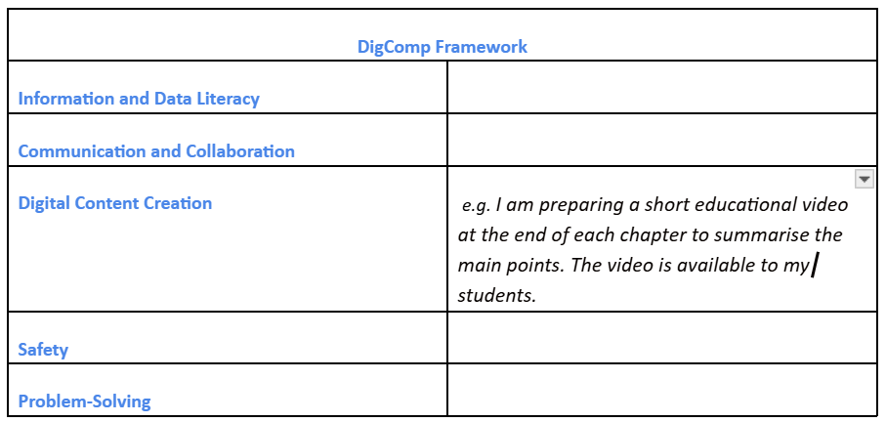
Unit 3: The DigComp, LifeComp Frameworks and relation to digital well-being
3.2 Activity - Implementing DigComp in Your Teaching
Step 1
Take a moment to think and reflect on the below questions:
Do I apply all five core areas of the DigComp Framework in my teaching?
Should I enhance the use of the DigComp Framework in my teaching? How can I achieve this?
Is there an area of DigComp that I am struggling to implement? How can I overcome this struggle?
Step 2
On a piece of paper, recreate the table that appears on the slide.
Step 3
Write one example of how you implement each core area of the DigComp Framework in your teaching.
Notes:
Give out the piece of paper

Slide 29
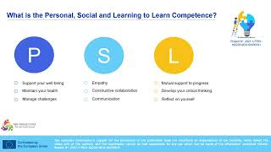
Unit 3: The DigComp, LifeComp Frameworks and relation to digital well-being
3.3 LifeComp (Life Competences) Framework
Personal, Social and learning to learn competence (ANI International)
Notes:
Watch this video as an introduction

Slide 30
Unit 3: The DigComp, LifeComp Frameworks and relation to digital well-being
3.3 LifeComp Framework
In the context of education, LifeComp encourages teachers to look beyond technical skills and nurture whole-person development.
It supports emotional regulation, lifelong learning, and ethical participation in digital communities, all of which are crucial for the PERMA-Digital approach to flourishing in digital spaces.
The LifeComp Framework of competences describes nine competences, organised in three areas:
Personal
Social
Learning to Learn

Slide 31
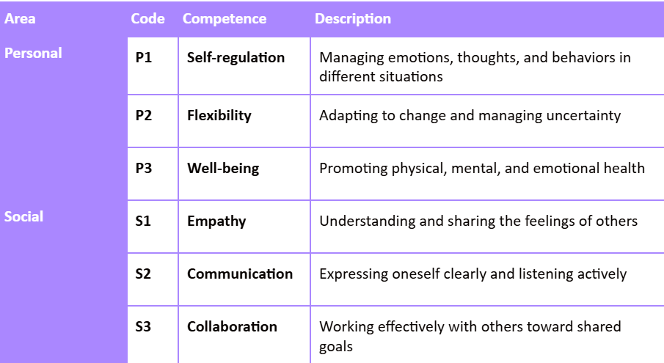
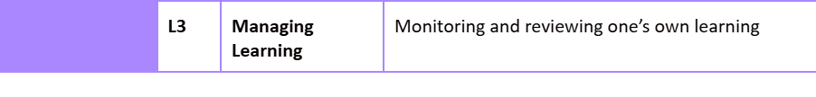
Unit 3: The DigComp, LifeComp Frameworks and relation to digital well-being
3.3 LifeComp Framework

Slide 32
Unit 3: The DigComp, LifeComp Frameworks and relation to digital well-being
3.3 LifeComp Framework
Personal Focuses on self-awareness, self-regulation, adaptability and well-being (physical, mental, and emotional) It involves recognising one’s strengths and emotions, managing stress, and developing a healthy mindset toward change and uncertainty. Example: Teachers practising mindfulness or reflection to maintain emotional balance before responding to challenging classroom situations.
Social Emphasises empathy, communication, collaboration, and conflict resolution. It prepares individuals to participate respectfully and constructively in diverse, digital communities. Example: Encouraging students to discuss different viewpoints in online forums or work together respectfully on group projects.
Learning to Learn Encourages curiosity, critical thinking, and motivation for continuous learning. It supports metacognition, the ability to plan, monitor, and evaluate one’s learning, both online and offline. Example: A teacher reflecting on how digital tools can support differentiated learning, or students setting personal learning goals using online resources.

Slide 33
Unit 3: The DigComp, LifeComp Frameworks and relation to digital well-being
3.3 Why you should care about LifeComp
LifeComp complements the DigComp framework by focusing on the personal and social competences that support responsible, balanced, and meaningful use of technology.
The application of the DigComp framework has highlighted gaps in well-being, self-regulation, awareness, responsibility, and critical thinking. These gaps can be addressed by integrating DigComp with the LifeComp framework.
DigComp -> focuses on what people do with digital tools
LifeComp -> focuses on how they think, feel, and interact when using them.
By applying LifeComp alongside DigComp, you can design learning experiences that promote both digital competence and well-being, helping students navigate technology with purpose, balance, and empathy.
Notes:
Additional information you could mention:
LifeComp helps educators and learners cultivate self-awareness, empathy, and resilience, qualities that are essential for maintaining digital well-being and positive relationships in connected environments.
Information and Data Literacy (DigComp) can be combined with Learning to Learn Competence (LifeComp) and, more specifically, Critical Thinking. For example, ask your students to select appropriate and reliable sources for their essay.

Slide 34
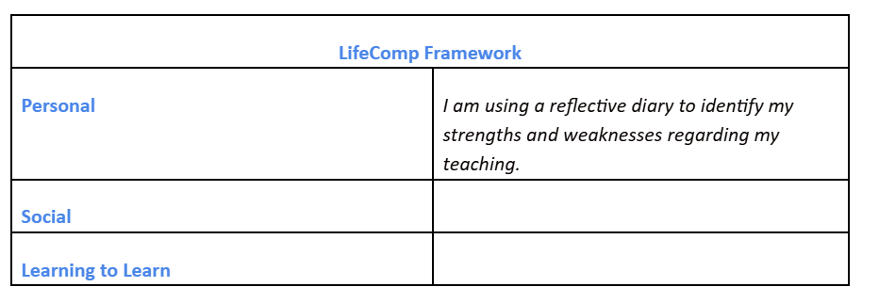
Unit 3: The DigComp, LifeComp Frameworks and relation to digital well-being
3.4 Activity 1 - Implementing LifeComp Framework in Your Teaching
Step 1
Take a moment to think and reflect on the below questions:
Do I apply the three core areas of LifeComp Framework in my teaching?
Should I enhance the use of LifeComp Framework in my teaching? How can I achieve this?
Is there an area of DigComp that I am struggling to implement? How can I overcome this struggle?
Step 2
On a piece of paper, recreate the table that appears on the slide.
Step 3
Write one example of how you implement each core area of the LifeComp Framework in your teaching.
Notes:
Give out the piece of paper

Slide 35
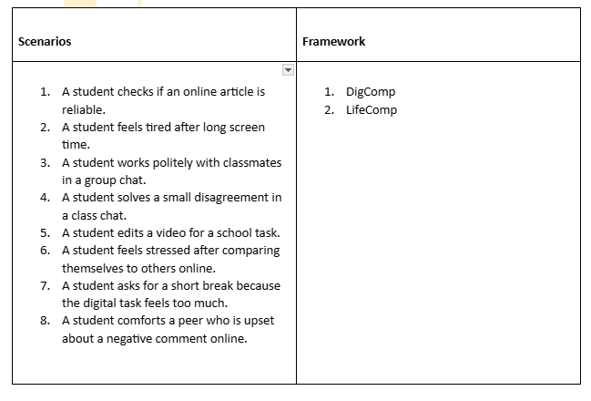
Unit 3: The DigComp, LifeComp Frameworks and relation to digital well-being
3.4 Activity 2 - Identifying DigComp and LifeComp competences
The goal of this activity is to see how digital skills and personal or social skills work together.
It will help you understand where your students need more support when they use technology.
Step 1
Read the eight scenarios.
Step 2
Place each one under DigComp or LifeComp.
NEED A SEPARATE SHEET FOR THIS ACTIVITY
After you place each scenario under the most relevant framework, take a moment to think:
Which specific competencies can be identified from both frameworks?
Notes:
Give out the piece of paper

Slide 36
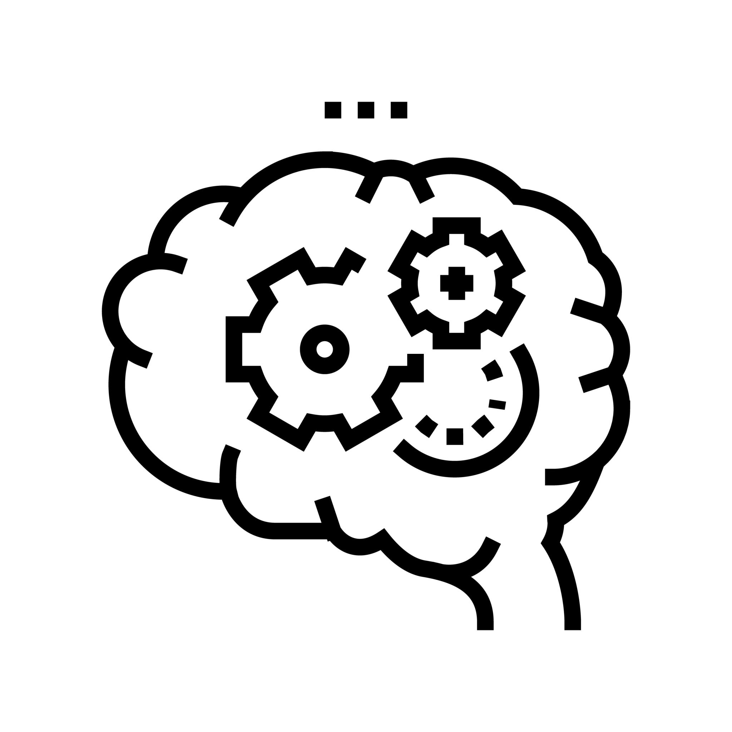
Unit 3: The DigComp, LifeComp Frameworks and relation to digital well-being
3.4 Activity 3 - Applying DigComp and LifeComp Frameworks separately in practice
This activity combines the following competences of DigComp Framework:
Information and Data Literacy
Communication and Collaboration
Digital Content Creation
Applying DigComp Framework by integrating specific competences
Think how each of the aforementioned competences can be implemented in class.

Slide 37
Unit 3: The DigComp, LifeComp Frameworks and relation to digital well-being
3.4 Activity 3 - Applying DigComp and LifeComp Frameworks separately in practice
For example, you can follow the steps to integrate the 2 competences mentioned above with your students:
Information and Data Literacy Ask your students to research a current issue online (e.g., environmental challenges). Before they start, guide your students to check whether online resources are reliable and how to credit their sources correctly.
Communication and Collaboration Then, ask them to collaborate in shared documents e.g. google drive, and Digital Content Creation, to create a digital presentation.
Now, think of another example that would show the implementation of the three aforementioned competences of DigComp Framework in class.
Then, write specific steps that you need to follow such as the example above.

Slide 38
Unit 3: The DigComp, LifeComp Frameworks and relation to digital well-being
3.4 Activity 3 - Applying DigComp and LifeComp Frameworks separately in practice
This activity reinforces two core areas of LifeComp Personal: Self-Regulation and Social: Empathy, linking emotional awareness to digital behaviour. Think how each of the aforementioned competences can be implemented in class.
2. Applying LifeComp Framework by integrating specific competences
Think how each of the aforementioned competences can be implemented in class.

Slide 39
Unit 3: The DigComp, LifeComp Frameworks and relation to digital well-being
3.4 Activity 3 - Applying DigComp and LifeComp Frameworks separately in practice
For example, you can follow the steps to integrate the 2 competences mentioned above with your students:
Self-regulation During a class discussion on social media use, ask your students to reflect on how online comments can impact others.
Empathy Then, lead a dialogue about empathy, emotional regulation, and respectful communication online.
Now, think of another example that would show the implementation of the two aforementioned competences of LifeComp Framework in class.
Then, write specific steps that you need to follow such as the example above.

Slide 40
Unit 3: The DigComp, LifeComp Frameworks and relation to digital well-being
3.4 Activity 4 - Connecting and Implementing the Two Frameworks in Class
When used together, DigComp and LifeComp frameworks will help you design learning experiences that are both technically competent and emotionally intelligent.
Here is what you need to do:
1. Think of a recent learning experience where you used both DigComp and LifeComp elements.
Before you write a short example from your class, consider what skills did students practice from DigComp and Life Comp Frameworks? For example, did they combine digital problem-solving with emotional regulation, collaboration, or critical thinking?
2. What challenges did you face when applying both frameworks at the same time?
Identify at least one challenge that you consider as very important, and suggest ways to address it next time. Consider issues such as time, student readiness, task complexity, or balancing digital skills with social and emotional demands.
Your students learn not only how to use technology but also why and when to use it responsibly, maintaining well-being and balance, which is the essence of the PERMA-Digital Framework.

Slide 41
Unit 3: The DigComp, LifeComp Frameworks and relation to digital well-being
3.5 Linking the two Frameworks (DigComp and LifeComp) to PERMA model
The PERMA model connects naturally with both DigComp and LifeComp, creating a holistic framework for digital well-being and flourishing in education.
Each PERMA element aligns with specific competences that help teachers and students thrive in digital environments. The table below shows the links between each PERMA element with specific competences of DigComp and LifeComp.

Slide 42
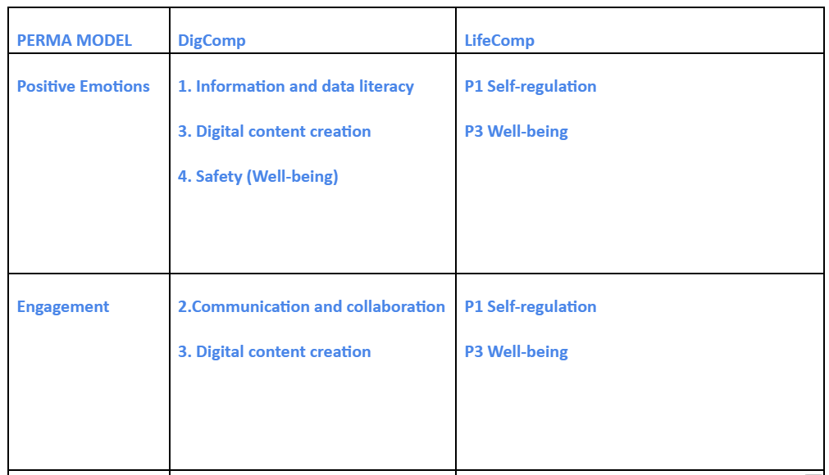
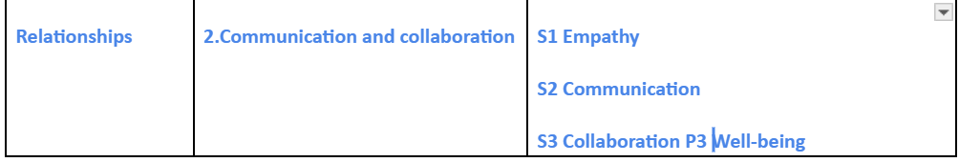
Unit 3: The DigComp, LifeComp Frameworks and relation to digital well-being
3.5 Linking the two Frameworks (DigComp and LifeComp) to PERMA model
Notes:
As you can see from the table above, the first element of PERMA model which is Positive Emotions is aligned with DigComp competences of Information and data literacy, Digital content creation, and Safety (Well-being) and simultaneously, is aligned with LifeComp competences self-regulation and well-being.

Slide 43
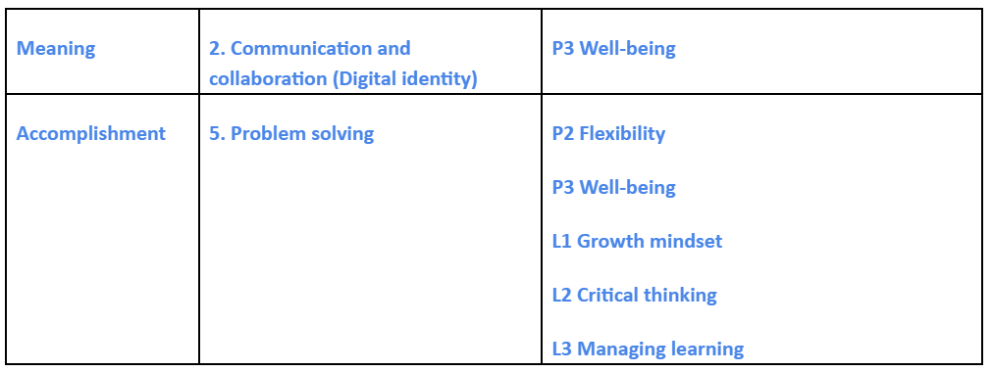
Unit 3: The DigComp, LifeComp Frameworks and relation to digital well-being
3.5 Linking the two Frameworks (DigComp and LifeComp) to PERMA model
Notes:
Table . Mapping DigComp and LifeComp to the PERMA model

Slide 44
Unit 3: The DigComp, LifeComp Frameworks and relation to digital well-being
3.5 Linking the two Frameworks (DigComp and LifeComp) to PERMA model
Positive Emotions
Aligns with LifeComp’s emotional regulation competencies, helping learners recognise and manage their feelings when using digital tools. Encouraging gratitude and optimism online can reduce stress and promote confidence in digital spaces. This is in line with Safety Competence of DigComp Framework.
Engagement
Connects with DigComp’s digital content creation and problem-solving areas, where students experience flow and satisfaction by engaging deeply with meaningful digital projects and creative learning activities. The creation of a digital project can make students feel better and enhance their well-being and confidence which is linked to LifeComp Framework.
Relationships
DigComp promotes collaborative communication, while LifeComp supports empathy and social awareness. Together, they help learners build trust, inclusion, and respect in online and blended learning communities.
Meaning
Supported by LifeComp’s personal and social competence areas, where learners connect their digital actions to values, identity, and purpose. Teachers can design tasks that let students explore how technology contributes to real-world goals and community impact. This is linked to Problem solving competence and Information and Data Literacy of DigComp Framework.
Accomplishment
Linked to DigComp’s goal-setting and self-assessment skills, helping learners track their digital progress and celebrate milestones. Combined with LifeComp’s self-regulation, it encourages perseverance, confidence, and pride in achievement.
Notes:
BEFORE SHOWING THE TABLE
Before you explore how the PERMA elements show up in daily life, let’s see each one through three lenses: psychological, behavioural, and emotional.
This shall give you a clear picture of how well-being grows through your thoughts, your actions, and your emotional experiences. It will also help you see what you can apply directly in your own life and in your work with students.
Tell the educators to read through the examples for each pillar and think of ways to grow these elements in their daily routine. Use a starter question like: What cultivates positive emotions for me?
To guide their thinking, mention these: • End your day by writing three specific things that brought you joy. • Pause and savour a positive moment for at least ten seconds when it happens. • Spend a few minutes in nature, art, or inspiring stories to spark awe.
AFTER
Show the table

Slide 45

Unit 3: The DigComp, LifeComp Frameworks and relation to digital well-being
3.5 Linking the two Frameworks (DigComp and LifeComp) to PERMA model
By connecting PERMA model, DigComp, and LifeComp Frameworks, you can design learning experiences that address both competence and character, ensuring that digital skills contribute to long-term well-being rather than just short-term performance.

Slide 46
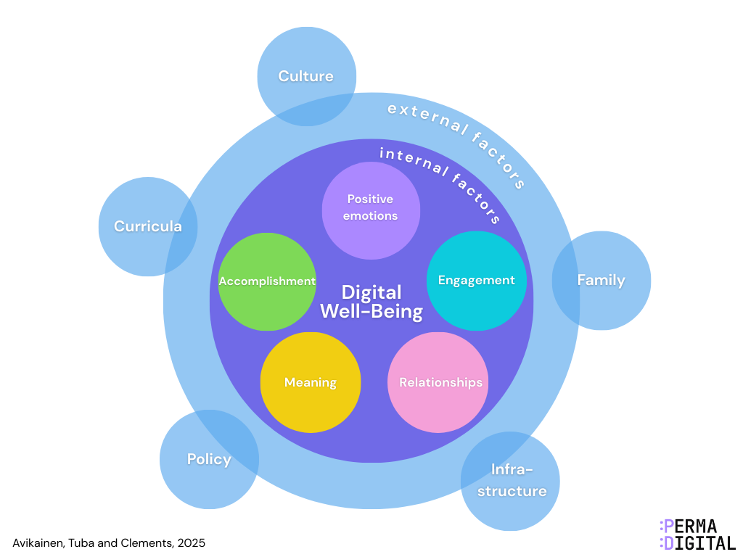
Unit 3: The DigComp, LifeComp Frameworks and relation to digital well-being
3.6 Internal and External Factors of the PERMA-Digital Framework
Notes:
The PERMA-Digital Framework integrates the psychological (PERMA), digital (DigComp), and socio-emotional (LifeComp) dimensions of well-being. To understand how these dimensions influence teaching and learning, the framework distinguishes between internal and external factors.
The Figure above illustrates how the PERMA elements in the inner cycle represent the internal factors of digital well-being, concentrating on the individual level.
Surrounding these are external factors that shape the choices and resources available to individuals in supporting their digital well-being. The PERMA Digital Well-being Framework places greater emphasis on the internal factors, as these can be effectively addressed through a whole-school approach. At the same time, the framework also provides recommendations for strengthening digital well-being in relation to external factors, though these are less easily and less rapidly influenced by the competence development of teachers, educators, parents, and students.

Slide 47
Internal Factors

Slide 48
Unit 3: The DigComp, LifeComp Frameworks and relation to digital well-being
3.6 Internal and External Factors of the PERMA-Digital Framework
Internal factors refer to the five elements of the PERMA model, comprising Positive Emotions, Engagement, Relationships, Meaning, and Accomplishment. These internal factors that can be actively nurtured and developed through education and parenting.
Therefore, PERMA elements represent the internal factors of digital well-being, concentrating on the individual level. Each PERMA element is linked closely to LifeComp’s personal and social competences and to DigComp’s focus on responsible, purposeful digital use.
In sum, they are the factors you influence most directly through learning activities, routines, and modelling.

Slide 49
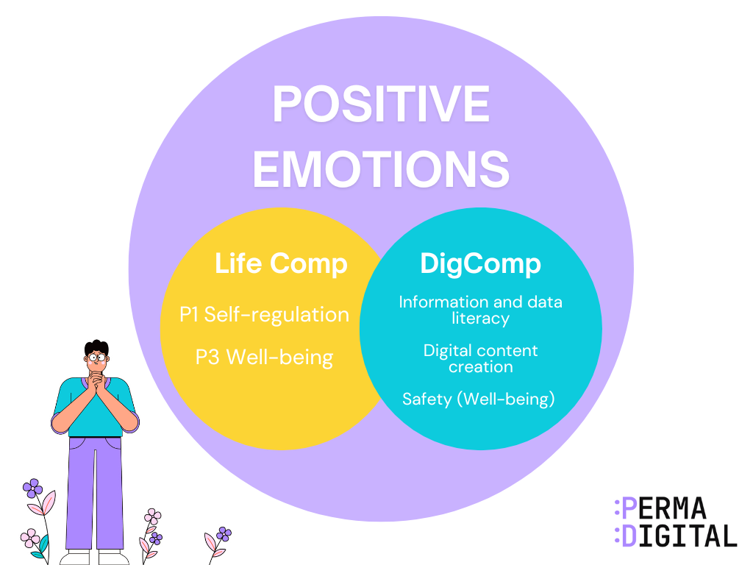
Unit 3: The DigComp, LifeComp Frameworks and relation to digital well-being
3.6 Internal and External Factors of the PERMA-Digital Framework
POSITIVE EMOTIONS | DIG COMP | LIFECOM
 | Information and Data Literacy: Learners would be instructed to use a digital tool to find trustworthy articles | P1 Self-regulation: Learners should be encouraged to develop self-awareness and emotional intelligence through reflective practices such as journaling
 | Digital Content Creation: Learners could use innovative digital tools to create a digital poster. | P3 Well-being: Learners should be encouraged to practice mindfulness techniques and strategies for emotional regulation
 | Safety (Well-being): Learners would be encouraged to take screen breaks during the online tasks and reflect on their activities.
Notes:
The table in this slide includes specific examples of how certain teaching strategies (that are linked to DigComp and LifeComp Frameworks), are combined with positive emotions.

Slide 50
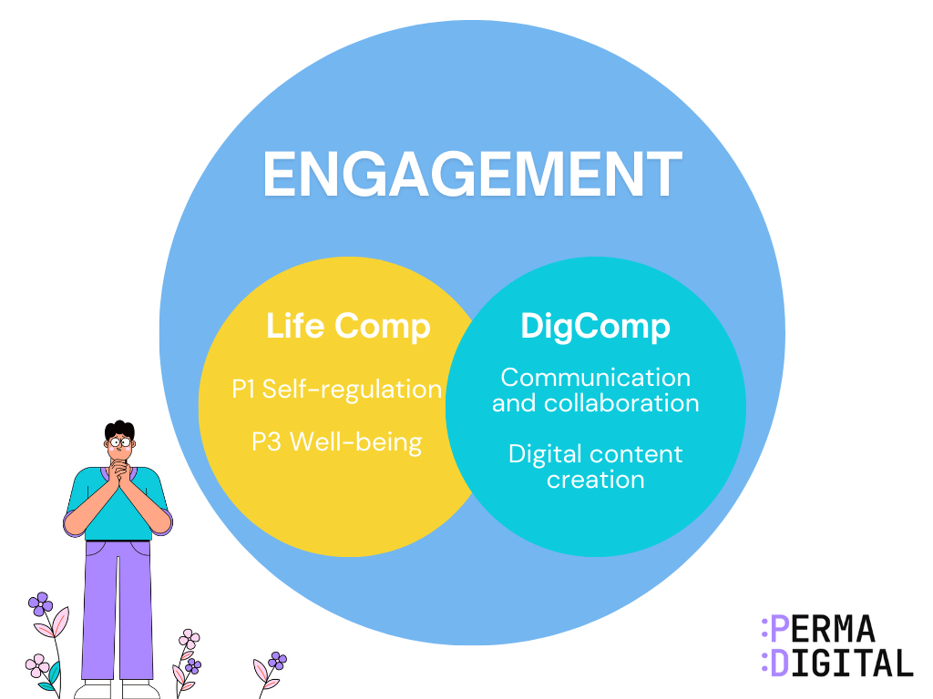
Unit 3: The DigComp, LifeComp Frameworks and relation to digital well-being
3.6 Internal and External Factors of the PERMA-Digital Framework
ENGAGEMENT | DIG COMP | LIFECOM
 | Communication and Collaboration: Teachers could use a game-based learning method, e.g. assign students to groups and take an online quiz. The winning team would win a prize. | P1 Self-regulation: Learners should be encouraged to develop self-awareness and emotional intelligence through reflective practices such as reflective logs or to provide feedback to their peers.
 | Digital Content Creation: Following the quiz, learners could use a digital tool to create a digital poster about the subject matter. | P3 Well-being: Learners should be encouraged to practice mindfulness techniques and strategies for emotional regulation
Notes:
The table in this slide includes specific examples of how certain teaching strategies (that are linked to DigComp and LifeComp Frameworks), are combined with Engagement.
.

Slide 51
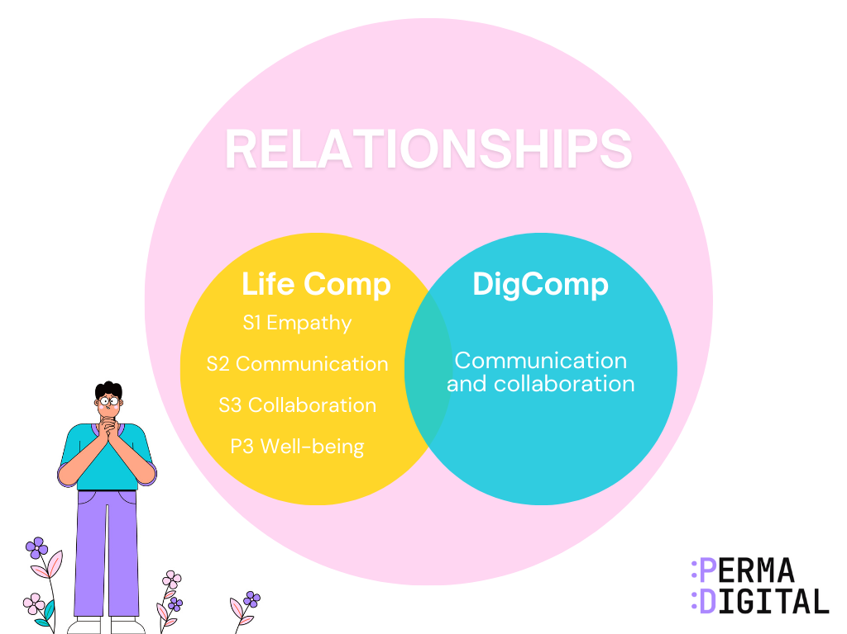
Unit 3: The DigComp, LifeComp Frameworks and relation to digital well-being
3.6 Internal and External Factors of the PERMA-Digital Framework
RELATIONSHIPS | DIG COMP | LIFECOM
 | Communication and Collaboration: Learners could be instructed to work on a collaborative learning project. Students should provide feedback/comments online and work together. | S1 Empathy: Learners would be encouraged by their teachers to share their feelings while working on the activity.
 | Digital Content Creation: Learners should create a digital presentation as a group. | S2 Communication: Learners would communicate respectfully in an online platform
 |  | S3 Collaboration: Learners would work effectively with others toward a shared goal
 |  | P3 Well-Being: Learners should be encouraged to reflect on their online interactions with their peers.
Notes:
The table in this slide includes specific examples of how certain teaching strategies (that are linked to DigComp and LifeComp Frameworks), are combined with Relationships.
.

Slide 52
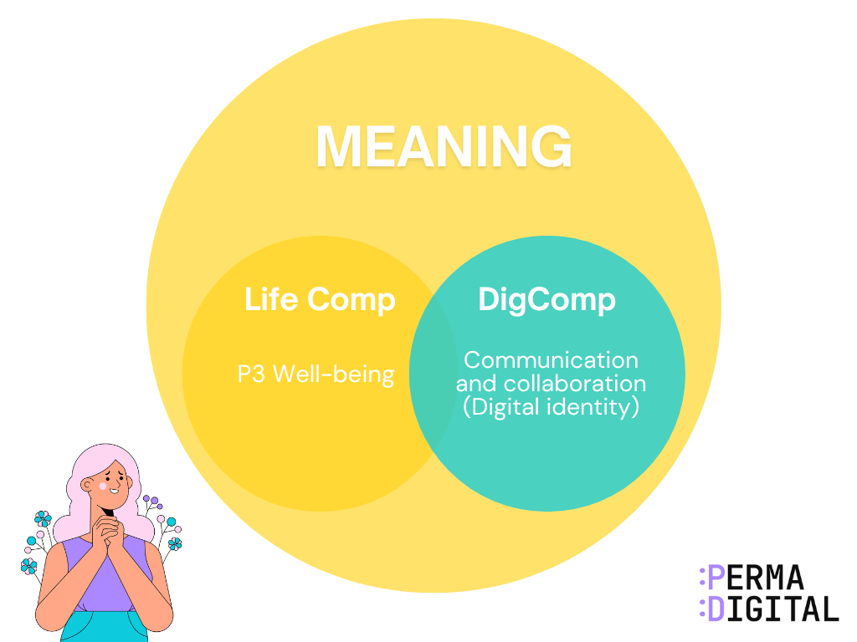
Unit 3: The DigComp, LifeComp Frameworks and relation to digital well-being
3.6 Internal and External Factors of the PERMA-Digital Framework
MEANING | DIG COMP | LIFECOM
 | Communication and Collaboration (Digital Identity): Teachers could initiate a discussion regarding ‘digital footprint’ and how learners can protect their digital identity in the online environment. Following that, teachers could assign the learners in different groups based on their strengths and personal values. | P3 Well-Being: Learners could be encouraged to reflect on their activities and discuss how the use of digital tools helped them to enhance their strengths.
Notes:
The table in this slide includes specific examples of how certain teaching strategies (that are linked to DigComp and LifeComp Frameworks), are combined with Meaning.
.

Slide 53
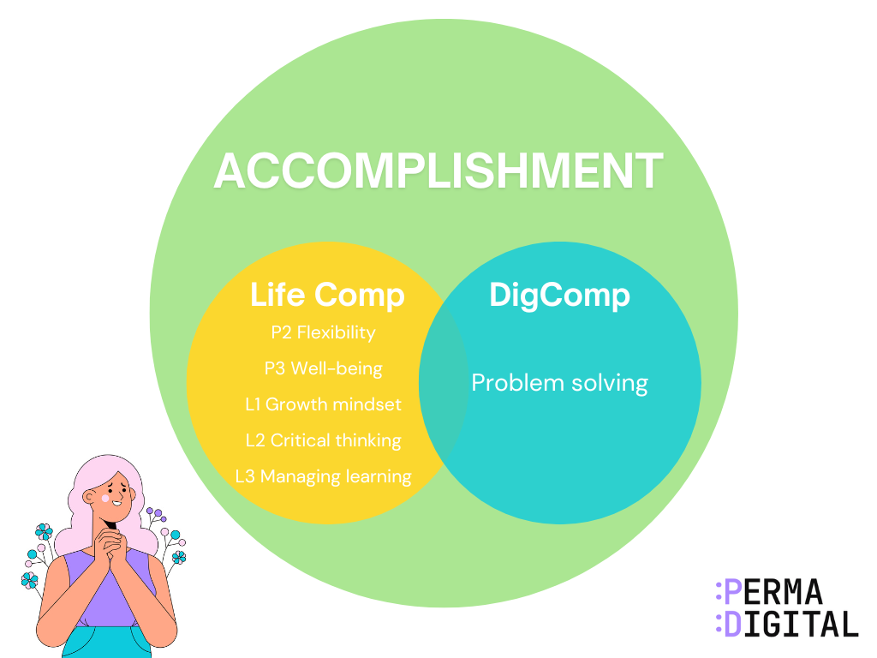
Unit 3: The DigComp, LifeComp Frameworks and relation to digital well-being
3.6 Internal and External Factors of the PERMA-Digital Framework
ACCOMPLISHMENT | DIG COMP | LIFECOM
 | Problem solving: Students could be encouraged to schedule online meetings to coordinate for the upcoming group presentation. As a result, the absence of students could be avoided and therefore, this will lead to better coordination between them. | P2 Flexibility: Let students experiment with multiple platforms (e.g., Canva, Notion, Miro) and reflect on what works best for them.
 |  | P3 Well-being: Build screen breaks into lessons to prevent overload.
 |  | L1 Growth Mindset: Set clear learning goals and let the learners to choose digital tools to reach them.
 |  | L2 Critical thinking: Learners could be encouraged to choose a digital tool to complete their assignment and then, to justify their tool use based on personal learning needs.
 |  | L3 Managing Learning: Learners could be instructed to organize the information in a meaningful way, and create short videos for each part using their preferred digital tool or a variety of tools.
Notes:
The table in this slide includes specific examples of how certain teaching strategies (that are linked to DigComp and LifeComp Frameworks), are combined with Meaning.
.

Slide 54
External Factors

Slide 55
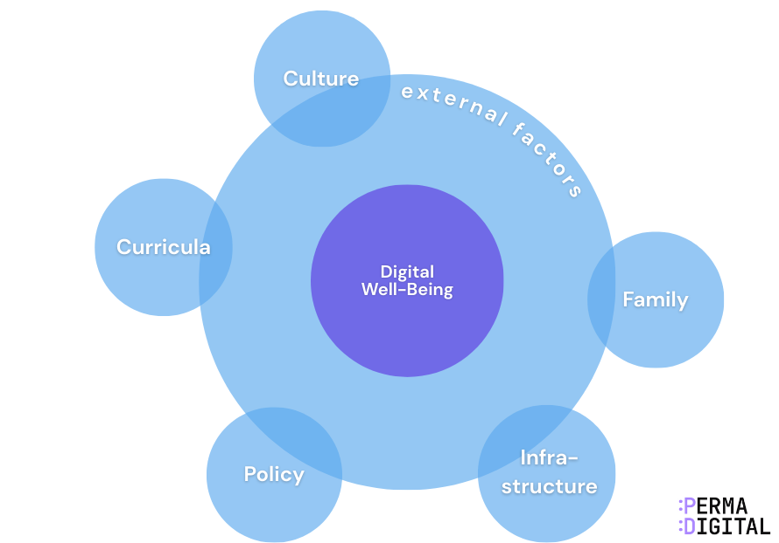
Unit 3: The DigComp, LifeComp Frameworks and relation to digital well-being
3.6 Internal and External Factors of the PERMA-Digital Framework
External factors
External factors play a significant role in shaping the digital well-being of adolescents, as they represent systemic, structural, and foundational influences that teachers and parents can only minimally affect.
Notes:
Recognising these external factors and providing targeted recommendations helps to strengthen safety, equity, and long-term digital resilience. These conditions are not controlled by students and often require coordination between teachers, school leadership, and families.
In sum, external factors play a significant role in shaping the digital well-being of adolescents, as they represent systemic, structural, and foundational influences that teachers and parents can only minimally affect. The figure below shows the external factors of PERMA-Digital Framework.

Slide 56
3.6 Internal and External Factors of the PERMA-Digital Framework
Links between External and Internal Factors

Slide 57
Unit 3: The DigComp, LifeComp Frameworks and relation to digital well-being
3.6 Internal and External Factors of the PERMA-Digital Framework
Curriculum
How often technology is used, and for what purpose, affects students’ attention, motivation, and balance. A well-designed curriculum mixes digital and non-digital learning so students stay engaged without overuse.
PERMA link: Engagement, Meaning
DigComp link: Purposeful, Structured digital use
LifeComp link: Managing learning
What to do
When your curriculum alternates between hands-on tasks, discussion, and digital activities, students stay alert and avoid fatigue. They understand why digital tools are used and how each task connects to learning goals, which increases Engagement and a sense of Meaning.
Embed digital well-being across all subjects, not just ICT or Health Education
Align national curricula with EU frameworks like DigComp, LifeComp, and PERMA to ensure emotional and social dimensions are addressed.

Slide 58
Unit 3: The DigComp, LifeComp Frameworks and relation to digital well-being
3.6 Internal and External Factors of the PERMA-Digital Framework
2. Policy
A school’s digital policies, routines, rules, and expectations shape how students behave online and offline.
Clear guidelines make digital use predictable and safe for students. When the school sets consistent expectations, your classroom becomes calmer, students switch between tasks more easily, and digital behaviour is more respectful.
PERMA link: Positive Emotions, Relationships, Accomplishment
DigComp link: Safe digital behaviour
LifeComp link: Self-regulation
What to do
When your school applies a simple rule such as “device-free transitions,” students move between lessons with fewer distractions. They arrive more focused and less overwhelmed, which improves mood (Positive Emotions), reduces unnecessary conflict (Relationships), and helps them start tasks with more confidence (Accomplishment).
Avoid simplistic bans on digital tools; instead, promote responsible and informed digital engagement
Support strategic planning to overcome resistance to innovation and ensure consistent implementation across schools.

Slide 59
Unit 3: The DigComp, LifeComp Frameworks and relation to digital well-being
3.6 Internal and External Factors of the PERMA-Digital Framework
3. Infrastructure
Access to devices, internet stability, and quality platforms influence how confident and successful students feel when working digitally. When access is reliable and fair, students participate more confidently and feel less stressed during digital tasks.
PERMA link: Engagement, Accomplishment
DigComp link: Confident digital participation
LifeComp link: Promotion of Well-being
What to do
When the school provides stable Wi-Fi and shared devices, students can join digital tasks without anxiety. This increases participation and gives all students a fair chance to succeed.
Prioritise capacity building over hardware provision, focusing on teacher competence and support systems
Ensure secure platforms and ethical AI use, with clear policies on data privacy and screen time monitoring.

Slide 60
Unit 3: The DigComp, LifeComp Frameworks and relation to digital well-being
3.6 Internal and External Factors of the PERMA-Digital Framework
4. Culture
Students are shaped by trends, online norms, and broader media environments. Viral content, influencers, and peer expectations affect emotions, self-image, and behaviour.
PERMA link: All elements (depending on context)
LifeComp link: Critical thinking, empathy
DigComp link: Understanding online behaviour, Problem solving
What to do
When a viral challenge spreads, students may compare themselves or feel pressured to participate. Recognising this helps you discuss emotional impact and guide them toward safer choices.
Co-develop with students, teachers, and parents to set shared norms for healthy tech use
Model Healthy Digital Habits
Engaging in guided, safe use of technology

Slide 61
Unit 3: The DigComp, LifeComp Frameworks and relation to digital well-being
3.6 Internal and External Factors of the PERMA-Digital Framework
5. Family
Family habits influence sleep, communication, motivation, and emotional stability.
Even strong classroom routines cannot always compensate for unhealthy patterns at home. Students who stay online late have difficulty concentrating, managing emotions, and participating in group work.
PERMA link: Positive Emotions, Relationships
LifeComp link: Well-being, flexibility
DigComp link: Safe and balanced digital habits
What to do
When your school establishes clear norms regarding responsible digital use, you should inform the families to implement the same norms at home.
This way, school and home would implement the same norms for responsible digital use. This would increase Positive emotions and Relationships.
Offer workshop and webinar sessions on digital stress, screen time, and online safety
Establish shared norms between school and home for responsible digital use.
Provide practical tips for setting boundaries and fostering self-regulation at home

Slide 62
Unit 3: The DigComp, LifeComp Frameworks and relation to digital well-being
3.7 Activity 1 - Synthesising PERMA, DigComp and LifeComp into the PERMA-Digital Model
TABLE: Synthesising PERMA
PERMA Element | DigComp Connection | LifeComp Connection
Positive Emotions | Safety in digital spaces | Emotional self-regulation, resilience
Engagement | Problem-solving, content creation | Managing learning, growth mindset
Relationships | Communication & collaboration | Empathy, teamwork
Meaning | Data literacy for informed decisions | Purpose, reflection, lifelong learning
Accomplishment | Digital projects & skill mastery | Goal-setting, persistence, adaptability
Notes:
The Table describes the PERMA Digital Framework areas. More specifically, the table shows the links between the PERMA components together with DigComp and LifeComp areas.
You can use this table to design activities that integrate well-being and digital and life competences.
For instance, when focusing on Positive Emotions, you might encourage students to use creative digital tools (e.g., digital storytelling, photo editing, or music apps) to express gratitude or joy. Similarly, for Engagement, you might use game-based learning platforms that promote flow and active participation.

Slide 63
Unit 3: The DigComp, LifeComp Frameworks and relation to digital well-being
3.7 Activity 1 - Synthesising PERMA, DigComp and LifeComp into the PERMA-Digital Model
Take a moment to think:
Which element of PERMA do you see most strongly supported by DigComp? Which by LifeComp?
Which PERMA element do you find easiest to link with DigComp and LifeComp?
Which element was most difficult to integrate — and why?
How does this synthesis give you a more complete picture of digital well-being?

Slide 64
Unit 3: The DigComp, LifeComp Frameworks and relation to digital well-being
3.7 Activity 2 - Understanding Internal and External Factors of the PERMA-Digital Framework
This activity will help you connect the PERMA-Digital model to your real classroom experience. It supports quick reflection, practical discussion, and immediate transfer to teaching.
Step 1
Think about your own students.
Write down three external factors that shape their digital experiences (for example: school device rules, family screen routines, access to stable internet).
Encourage participants to write short, concrete examples rather than general statements.
Step 2
Match the 4 scenarios that follow with the appropriate internal (PERMA ELEMENT, DigComp, and LifeComp) or external factors (Family, Policy, Culture, Infrastructure, Curricula). Use the example to guide you:

Slide 65
Unit 3: The DigComp, LifeComp Frameworks and relation to digital well-being
3.7 Activity 2 - Understanding Internal and External Factors of the PERMA-Digital Framework
Example
Scenario | Internal factor(s) | External factor(s)
Example “Students get frustrated when an app freezes.” | PERMA: Positive Emotions LifeComp: Self-regulation
Example “Inconsistent rules about device use” |  | School condition: Clear digital policies
A student is upset because he received a negative comment in the online chat room.
Not all students have access to the internet at school and home.
Students are working together in small groups in an online platform to prepare a digital presentation.
A lesson plan includes digital and non-digital activities.
Notes:
Handout this in a sheet of paper and distribute - if possible.

Slide 66
Unit 3: The DigComp, LifeComp Frameworks and relation to digital well-being
3.7 Activity 2 - Understanding Internal and External Factors of the PERMA-Digital Framework
Step 3
This step will help you realise how internal and external factors interact in real teaching. For each scenario note one mismatch or challenge.
Use examples like:
• “Our students have good emotional self-awareness, but the school uses too many apps, so they still feel overwhelmed.” • “Families set healthy routines at home, but students struggle to regulate focus during digital lessons.” • “We have strong school policies, but students lack the skills to apply them consistently.”

Slide 67
End of Unit 3
Introduction to Digital Well-being: the PERMA-Digital Frameworks

