Slide 1
Thriving Schools - A Systemic, Whole-School Approach to Mental Health and Well-Being
Project duration: 36 months (Mar 2025 - Feb 2028)
Project No: 101196057
Call: ERASMUS-EDU-2024-POL-EXP

Slide 2
WP 3: Training and capacity building (D3.1)
Master Trainer Course - Day 1

Slide 3
Foundations of Holistic Well-being & Positive Psychology
Introduction
Day 1 overview:
The main objective is to help teachers build a shared and practical understanding of well-being in schools. They define what well-being means, examine how it shows up in daily school life, and identify what currently works and what needs improvement.
Unit Breakdown:
Unit 1.1 (Define): Build a shared understanding of school well-being.
Participants define well-being, identify challenges in their school, and note current strengths and gaps.
Unit 1.2 (Explore): Learn the core elements of Positive Psychology with PERMA.
Participants connect PERMA to real routines and see how small daily actions support emotional, social, and academic functioning.
Unit 1.3 (Apply): Identify quick wins that improve well-being in classrooms and staff culture.
Participants choose one action they can start next week and agree on who will do what.

Slide 4



Unit 1.2 – Introduction to PERMA Model
Learning objectives
By the end of this unit, participants will be able to:
• Name and explain the five elements of the PERMA model.
• Select three strategies that fit your school’s context and needs.
• Draft one small action, including timeline and responsible person.

Slide 5

Unit 1.2 – Introduction to PERMA Model
Think of a real school day that felt successful.
Not theory. A day when you left feeling satisfied and proud.
What made that day good?
• You felt calm and focused
• Students were engaged in learning
• Collaboration with students or colleagues worked smoothly
• You saw progress or impact
👉 Share one short example.
Why we start here:
Well-being is not an extra task. It lives in daily experiences inside the school.

Slide 6
Unit 1.2 – Introduction to PERMA Model
Connecting Your Responses to PERMA
We will place each example under a PERMA element:
Your examples show what makes a school day meaningful.
We will now collect three responses from the group.
Share one short example that made your school day good.
Objective of this activity:
To show that many positive moments already happening in your school are part of the PERMA model.
PERMA Element | What it may reflect in your example
Positive Emotions | Feeling calm, supported, encouraged
Engagement | Students fully focused and absorbed in learning
Relationships | Trust, collaboration, positive interactions
Meaning | Feeling that the day had purpose and impact
Accomplishment | Progress, success, completion of a task or goal

Slide 7
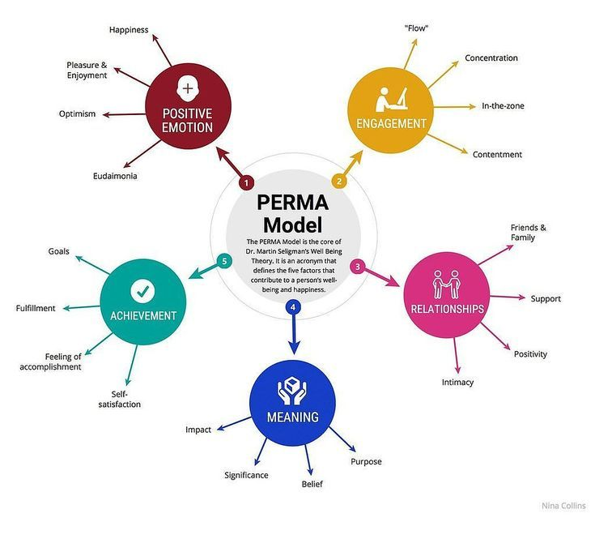
Unit 1.2 – Introduction to PERMA Model
PERMA Overview
PERMA Overview
PERMA is a science-based model that explains what helps people function and feel well.
PERMA stands for:
• Positive Emotions
• Engagement
• Relationships
• Meaning
• Accomplishment
How we use PERMA in schools
• When these elements are present, students learn better
• Teachers experience less stress and more purpose
• School climate improves through daily routines and consistent practices
You will learn how to identify PERMA in your school and how to incorporate it into your daily routines.

Slide 8
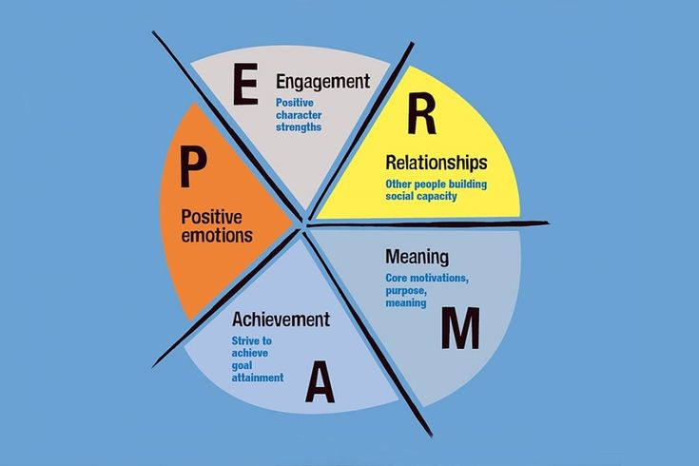
Unit 1.2 – Introduction to PERMA Model
Copy/paste the slide as many times as needed – but avoid overloading.
Positive Emotions (P)
What this means in schools
• Students and staff experience calm, encouragement and moments of joy
• The environment reduces pressure and supports emotional regulation
What this looks like in practice
• Teachers greet students at the door
• Short gratitude routine at the end of the day
• Calm transition between activities (timer, quiet music, breathing)
Result in school life
• Students are more ready to learn
• Teachers handle challenging moments with more patience

Slide 9
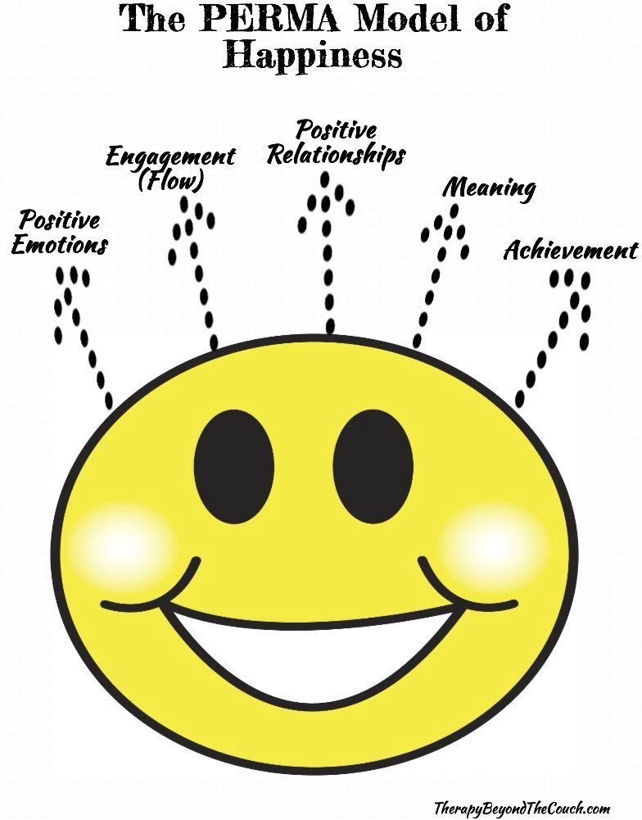
Unit 1.2 – Introduction to PERMA Model
Copy/paste the slide as many times as needed – but avoid overloading.
Engagement (E)
What this means in schools
• Students participate actively and stay focused
• Tasks match ability and include choice
What this looks like in practice
• Choice board with learning options
• Hands on project or inquiry activity
• Clear working blocks with a visual agenda
Result in school life
• Fewer distractions and off task behaviours
• Higher participation from students who usually stay quiet

Slide 10
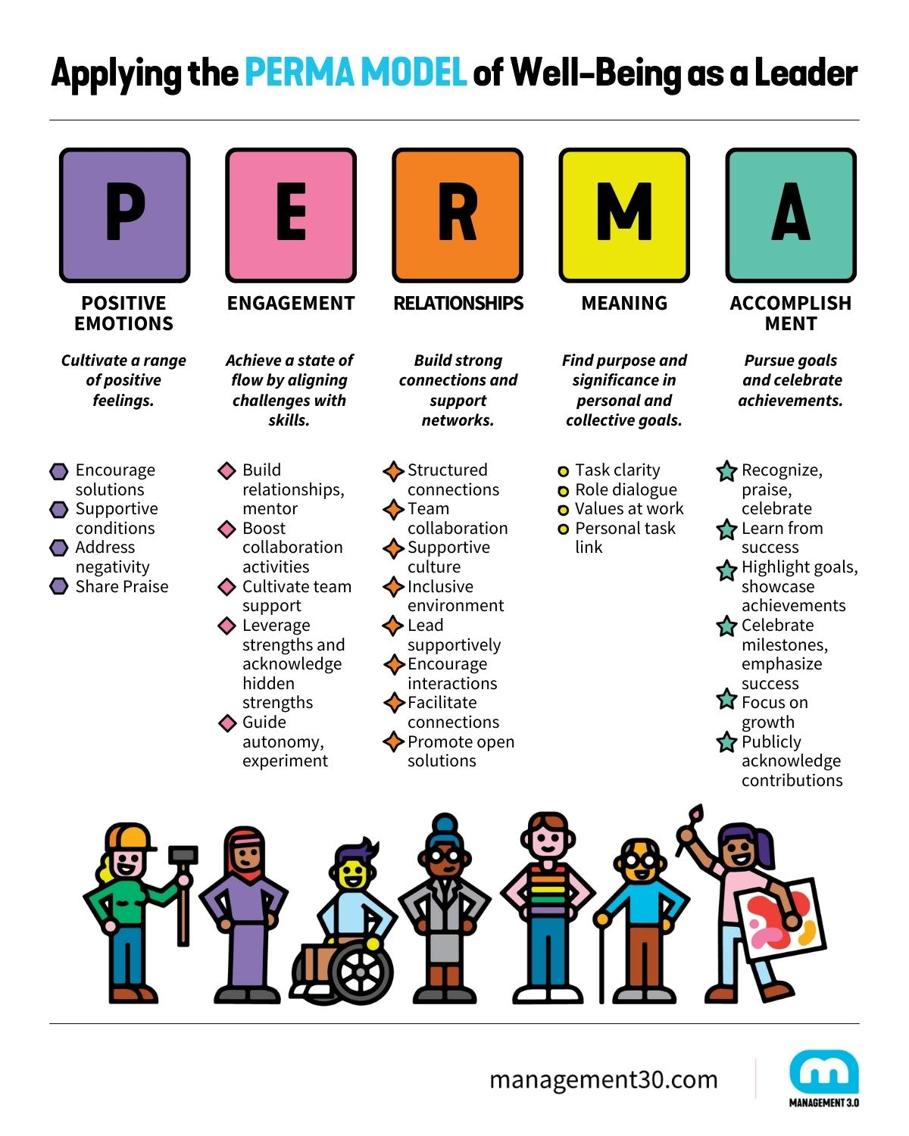
Unit 1.2 – Introduction to PERMA Model
Copy/paste the slide as many times as needed – but avoid overloading.
Relationships (R)
What this means in schools
• Students and staff feel accepted, supported and seen
• Interactions are respectful and predictable
What this looks like in practice
• Morning check ins in class
• Pair buddy system or peer support
• Teachers use names, invite opinions and acknowledge effort
Result in school life
• Better behaviour and fewer conflicts
• Greater trust between teachers and students

Slide 11

Unit 1.2 – Introduction to PERMA Model
Meaning (M)
What this means in schools
• Students understand the purpose behind the activity
• Teachers communicate the “why,” not only the “what”
What this looks like in practice
• Start lesson with one sentence: “Why this matters”
• School projects linked to real issues (eco team, student council)
• Students help plan or present learning outcomes
Result in school life
• Higher motivation and commitment
• Reduced resistance to challenging tasks

Slide 12
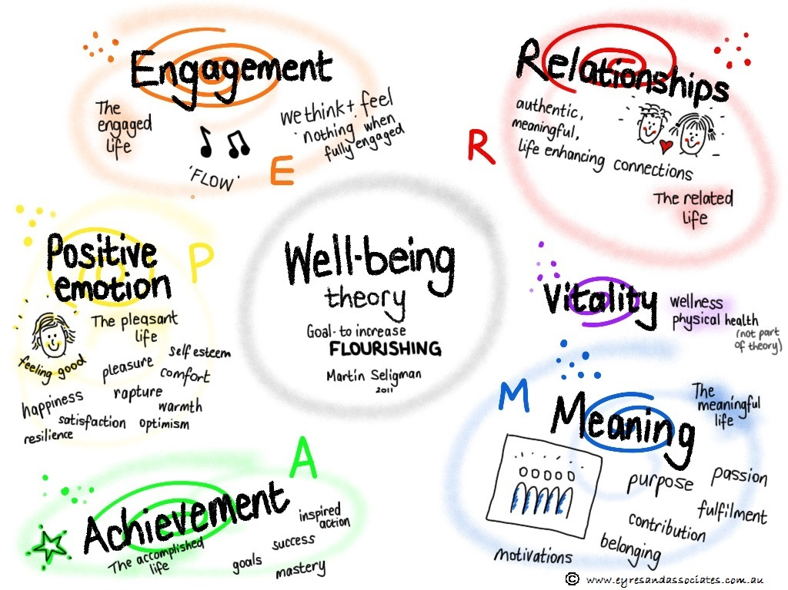
Unit 1.2 – Introduction to PERMA Model
Copy/paste the slide as many times as needed – but avoid overloading.
Accomplishment (A)
What this means in schools
• Students and teachers see progress and small wins
• Goals are concrete and visible
What this looks like in practice
• Weekly goal cards: “This week I will…”
• Visible progress tracker (wall chart or planner)
• Short feedback cycle: what improved since last time
Result in school life
• Students feel capable
• Teachers see impact of their instruction

Slide 13
Unit 1.2 – Introduction to PERMA Model
PERMA: Five elements that support well-being in schools
PERMA describes five elements that support well-being in a school environment.
Below you see what each element looks like in real action.
PERMA Element | What it means in school life | Short classroom example
Positive Emotions | Students and staff experience calm moments, encouragement, and joy during the day. | End of lesson activity: Three Good Things. Each student writes one positive moment.
Engagement | Students focus and stay absorbed in learning tasks that match their ability level. | Choice activity. Students pick how to present learning.
Relationships | People feel seen, respected, and supported. Belonging is visible. | Greeting students at the door. Short check in question.
Meaning | Students understand the purpose of learning and connect it to real life. | Start the lesson with one sentence: Why this matters.
Accomplishment | Students notice progress and celebrate small successes. | Weekly goal card. Quick reflection at the end of the week.
You can support PERMA with simple routines. Small actions, done daily, change the school culture.

Slide 14
Unit 1.2 – Introduction to PERMA Model
From Understanding to Action
You now know the five PERMA elements and how they show up in school life.
Before exploring specific activities, we will take one step:
Connect PERMA to your school reality.
In Unit 1.1 you identified:
• current strengths in well-being
• current challenges or gaps
We will now use these and place them under the PERMA elements.
This helps us see which part of well-being needs the most attention in your school.
When we know where the need is, we can choose what activity to apply.

Slide 15
Unit 1.2 – Introduction to PERMA Model
PERMA Mapping (10 min)
Task
Work with your group and categorise the strengths and challenges from Unit 1.1 under the PERMA elements:
Positive Emotions | Engagement | Relationships | Meaning | Accomplishment
Steps
Place each strength or challenge into the relevant column.
Look at the column with the highest number of challenges.
This shows the area that needs priority.
Circle or highlight that element.
Goal
Each school identifies one PERMA element that needs improvement.
Transition to Demonstration
Now that you have identified which PERMA element needs support:
• You will experience a short well-being activity
• You will see how simple routines can change the climate
• You may decide to apply this in your school
We move from diagnosing the need to testing a solution.

Slide 16

Unit 1.2 – Introduction to PERMA Model
Activity Demonstration: “Three Good Things” (15 min)
You will try one activity that strengthens the Positive Emotions element of PERMA.
Instructions
• Take a paper or post-it
• Write three good things that happened today
• Under each one, write: “What helped this happen”
Pair Share
Exchange one of your good things with someone next to you.
Takeaway
Positive emotions are not random.
Small routines can create them.

Slide 17
Unit 1.2 – Introduction to PERMA Model
Adapt the Activity to Your Context
Where will we apply it? | Who is involved? | When and how often? | What exactly will we do? | Materials needed
Classroom / Staff / Other | Students / Teachers / Whole school | Daily / Weekly / End of lesson | Short description of the routine (steps in 1–2 lines) | Post-its, paper, timer, board
Work in pairs. Complete each column. Keep the plan specific and realistic.

Slide 18
Unit 1.2 – Introduction to PERMA Model
Introduction to the PERMA Evidence Walk
You already identified strengths and challenges in your school during Unit 1.1.
Instead of adding new ideas, we will now use what you already have and see how they connect to PERMA.
This activity will help you:
• Visualise what is working in your school
• Spot patterns across the PERMA elements
• Decide which element needs attention first
You will move around the room, place your notes on the PERMA posters, and observe where the strengths and gaps appear.
The goal is clarity: which part of well-being needs action right now.

Slide 19
Unit 1.2 – Introduction to PERMA Model
PERMA Evidence Walk (20 min)
You will now analyze your school reality through PERMA using movement and tagging, rather than tables.
Instructions (Groups):
Around the room, you will see five posters on the wall.
Each poster represents one PERMA element.
Take your post-its from Unit 1.1 (strengths and challenges).
Do not generate new content.
Walk around the posters and tag each post-it under the PERMA element it belongs to.
• Green post-it = current practice that works
• Yellow post-it = challenge or gap
Purpose
To create a visual picture of where PERMA already exists in your school and where gaps accumulate.

Slide 20
Unit 1.2 – Introduction to PERMA Model
Pattern Analysis: What do we see
Stand in front of the posters and discuss as a group.
Guiding questions
• Which PERMA poster has the most green tags (strengths)
• Which PERMA poster has the most pink tags (challenges)
• Where is the biggest gap between current and desired practice
Your task
Write one sentence:
“Our priority PERMA element is ______ because ______.”
This priority will guide your action plan in the next unit.

Slide 21
Unit 1.2 – Introduction to PERMA Model
Summary & Reflection (5 min)
You explored how the five PERMA elements connect to real school life.
You also identified which element your school needs to strengthen.
Now take one final step before leaving this unit.
Task (individual or pairs):
Choose the PERMA element you want to focus on in your school.
Think of one small routine or practice you could start within the next month.
Keep it simple — something realistic for your context.
Write it on a sticky note:
• The PERMA element
• The activity you want to try
• One short reason why it matters for your school
Place your sticky note on the shared board.
You leave this unit with one clear action that fits your school’s needs and capacity.

Slide 22
Unit 1.2 – Introduction to PERMA Model
Summary & Reflection (5 min)
PERMA Action Board
Place your sticky note under the PERMA element you chose.
Write:
• the activity you will start
• when you will start
Positive Emotions | Engagement | Relationships | Meaning | Accomplishment
(sticky notes here) | (sticky notes here) | (sticky notes here) | (sticky notes here) | (sticky notes here)

Slide 23

Looking Ahead to Unit 1.3: Introduction to Whole School Approaches (WSA)
In the next unit, we shift from individual practices to whole school change.
You will explore what a Whole School Approach is and how it shapes culture and routines.
You will learn how to apply three school-wide strategies that support well-being in daily practice.
You will compare these strategies with your current school reality and check if they align with your school ethos.
You will also examine a real case of a school that applied a well-being initiative across staff, students, and families.
You leave the next unit with a clear direction on how well-being becomes part of the way your school operates every day.

Slide 24
References
Duan, W., Chen, Z., & Ho, S. M. Y. (2020). Editorial: Positive education: Theory, practice, and evidence. Frontiers in Psychology, 11, 427. https://doi.org/10.3389/fpsyg.2020.00427
Durlak, J. A., Weissberg, R. P., et al. (2011). The impact of enhancing students’ social and emotional learning: A meta-analysis of school-based interventions. Child Development, 82(1), 405–432. https://doi.org/10.1111/j.1467-8624.2010.01564.x
OECD. (2020). Supporting students’ well-being in schools. Organisation for Economic Co-operation and Development.
Roffey, S. (2012). Developing positive relationships in schools. Child Indicators Research, 5(3), 483–501. DOI:10.1007/978-94-007-2147-0_9
Seligman, M. E. P. (2011). Flourish: A visionary new understanding of happiness and well-being. Free Press.
UNESCO. (2023). Whole-school approach to preventing school violence and promoting well-being. United Nations Educational, Scientific and Cultural Organization.
Waters, L. (2011). A review of school-based positive psychology interventions. Pastoral Care in Education, 29(2), 117–133. https://doi.org/10.1375/aedp.28.2.75
World Health Organization. (2021). WHO guideline on school health services. World Health Organization.

Slide 25
Thank you for your attention!

Slide 26
https://thrivingschools.eu/

Slide 27
Elements Slide
Copy paste the elements below into your presentation as required.
Quote text/Hightlight text
Button

