Slide 1
Thriving Schools - A Systemic, Whole-School Approach to Mental Health and Well-Being
Project duration: 36 months (Mar 2025 - Feb 2028)
Project No: 101196057
Call: ERASMUS-EDU-2024-POL-EXP

Slide 2
WP 3: Training and capacity building (D3.1)
Master Trainer Course - Day 1

Slide 3
Foundations of Holistic Well-being & Positive Psychology
Introduction
Day 1 overview:
The main objective is to help teachers build a shared and practical understanding of well-being in schools. They define what well-being means, examine how it shows up in daily school life, and identify what currently works and what needs improvement.
Unit Breakdown:
Unit 1.1 (Define): Build a shared understanding of school well-being.
Participants define well-being, identify challenges in their school, and note current strengths and gaps.
Unit 1.2 (Explore): Learn the core elements of Positive Psychology with PERMA.
Participants connect PERMA to real routines and see how small daily actions support emotional, social, and academic functioning.
Unit 1.3 (Apply): Identify quick wins that improve well-being in classrooms and staff culture.
Participants choose one action they can start next week and agree on who will do what.

Slide 4



Unit 1.1 – Introduction to Well-being in Education
Learning objectives
By the end of this unit, participants will be able to:
Define well-being in the school context and explain why it matters.
Identify at least three well-being challenges relevant to their own school environment.
Map current well-being practices in their schools, highlighting strengths and areas for improvement, using established well-being indicators as a reference.

Slide 5

Unit 1.1 – Introduction to Well-being in Education
Quick Check-In: One Word on School Well-being
Think of one word that describes what well-being in school means to you.
Say your word when it is your turn.
Examples
SAFE • BELONGING • SUPPORT • INCLUSION • RESPECT • HAPPINESS • TRUST

Slide 6

Unit 1.1 – Introduction to Well-being in Education
Definition of School Well-being (WHO, UNESCO)
Definition of School Well-being (WHO, UNESCO)
  School well-being is a measurable condition where:
    Students and staff feel physically and emotionally safe.
    • Relationships are respectful, supportive, and fair.
    • The school climate reduces stress and allows focus.
    • Participation and belonging are ensured for every student.
  According to global guidelines, a school should protect well-being with planned actions, not one-off activities.

Slide 7
Unit 1.1 – Introduction to Well-being in Education
What is School Well-being: National / Education System Perspective
School well-being is a core quality indicator of education.
Policies state that schools must:
Create conditions where learning, teaching, and relationships can thrive without unnecessary pressure.
Protect the mental and physical health of students and staff.
Strengthen collaboration among teachers, families, and the wider school community.
Promote a positive culture through routines, rules, and daily practices.

Slide 8





Unit 1.1 – Introduction to Well-being in Education
Model of Well-being in
A complete approach to well-being includes four linked domains:
Emotional
• Students and staff can recognise, express, and manage emotions.
• The environment protects emotional safety through clear routines and supportive communication.
Social
• Positive relationships, a sense of belonging, and fair treatment.
• Collaboration and respect guide student and staff interactions.
Physical
• Safe buildings, healthy routines, balanced workload.
• Access to movement, breaks, and basic needs supports energy and focus.
Cognitive
• Learning happens without overload or fear of mistakes.
• Tasks match ability, promote focus, and build success over time.

Slide 9
Unit 1.1 – Introduction to Well-being in Education
School Well-being Model
School well-being includes four domains:
Emotional
• Students and staff can understand and manage emotions.
• The climate supports calm and confidence.
Social
• Relationships are positive and respectful.
• Everyone feels accepted and connected.
Physical
• Safe spaces and healthy routines protect energy and focus.
• Movement, rest, and basic needs are planned into the day.
Cognitive
• Learning tasks support focus and autonomy.
• Students experience success and progress.
Why this matters
When all four domains are supported, learning improves and stress decreases.
Which domain receives the most attention in your school?
Emotional
Social
Physical
Cognitive

Slide 10
Unit 1.1 – Introduction to Well-being in Education
School Context Scenarios (15 min)
Scenario A: Urban / High Academic Pressure
Context
• Large school in city center
• Frequent exams and competitive culture
• Short breaks, back-to-back lessons
• Teachers report exhaustion and absenteeism
Observation
Learning takes priority. Emotional and physical needs are ignored.
Group task (2 min)
Identify three well-being risks for:
• Students
• Teachers
Write them on your sheet.
Scenario B: Rural / Limited Services
Context
• Small school, strong relationships
• Limited specialist support (counselor, psychologist)
• Teachers handle multiple roles
• No structured well-being routines
Observation
Social connection is strong. System support is weak.
Group task (2 min)
Identify gaps in:
• Support structures
• Daily routines
Write your three biggest risks.
Scenario C: Transition / Mixed Culture
Context
• New leadership introduces change
• Inconsistent routines across classrooms
• Several peer conflicts reported
• Some teachers resist new approaches
Observation
School has motivation but lacks consistent practice.
Group task (2 min)
Identify three barriers that block well-being progress.
Record on flip chart.

Slide 11

Unit 1.1 – Introduction to Well-being in Education
Group Activity: Identify Challenges + Propose Practices
Scenario A: Urban / High Academic Pressure Context
Scenario B: Rural / Limited Services
Scenario C: Transition / Mixed Culture
Review your scenario (A, B, or C).
Identify the well-being challenges you notice• Emotional• Social• Physical• Cognitive
Agree on your top three challenges.
Propose one practical action your school could take for each challenge.•
Keep actions small and doable within 2–4 weeks.
Record your three challenges + three practices on flip chart paper.

Slide 12
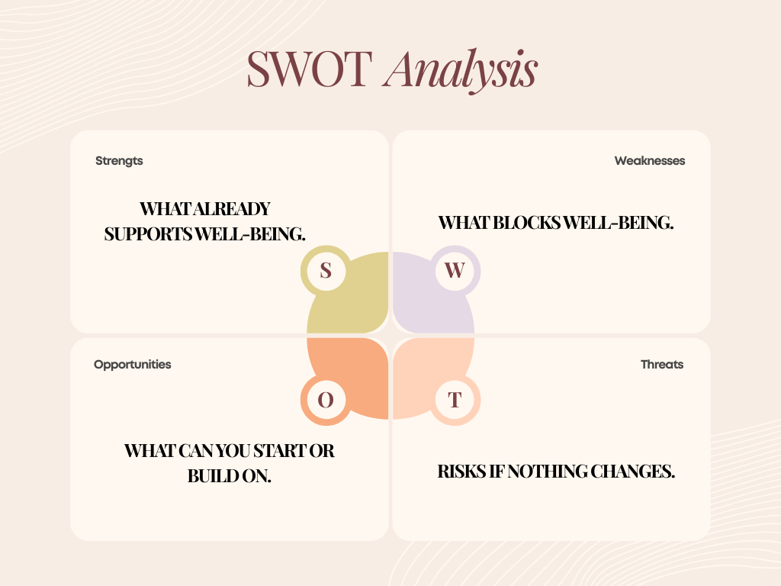
Unit 1.1 – Introduction to Well-being in Education
School Challenge Mapping
Purpose
Understand the current situation before planning actions.

Slide 13
Unit 1.1 – Introduction to Well-being in Education
Mapping Current Practices
SWOT area | Meaning in this activity | What you write
Strengths | Practices that already work well and support well-being. | “Morning greeting routine in all classes.”
Weaknesses | Practices that are missing, inconsistent, or ineffective. | “No structured break for teachers.”
Opportunities | Practical ideas you could start soon with existing resources. | “Introduce two-minute emotional check-in.”
Threats | Risks that could block or damage well-being progress. | “Workload prevents consistency.”
Now that you have identified challenges through the SWOT analysis, you will focus on daily practice.
We move from diagnosis to evidence of what actually happens in school life.
Using your SWOT map, choose one area that affects well-being the most.
In groups (10 min):
List current practices related to that area.
Mark each as:
• Strength (works well today)
• Gap (needs improvement or missing)
Focus:
• Write what people do, not what they believe.
• Be specific and observable.
This step prepares you for planning new practices later in the session.
Key rule
You map practices, not opinions.
Examples of what NOT to write:
✖ “Teachers care about students.”
✖ “We want better relationships.”
Examples of what to write (observable):
✔ “Teachers greet students at classroom door each morning.”
✔ “Students complete a short emotional check-in every Monday.”

Slide 14

Unit 1.1 – Introduction to Well-being in Education
Summary & Reflection
Key takeaways
• We defined school well-being using a shared language.
• We identified three current challenges in our context.
• We mapped one strength and one gap in existing practices.
Reflection task
Write one specific change you will introduce in your school this term.
It must be realistic, measurable, and linked to daily practice.
Share
Selected participants present their planned change.

Slide 15

Looking Ahead to Unit 1.2: Introduction to the PERMA Model
In the next unit, we focus on what helps people thrive at school.
We will explore Seligman’s PERMA model and how each element supports well-being in daily school life.
You will learn one evidence-based practice you can use with students or staff.
You will identify one strength and one gap related to PERMA in your school.

Slide 16
References
Duan, W., Chen, Z., & Ho, S. M. Y. (2020). Editorial: Positive education: Theory, practice, and evidence. Frontiers in Psychology, 11, 427. https://doi.org/10.3389/fpsyg.2020.00427
Durlak, J. A., Weissberg, R. P., et al. (2011). The impact of enhancing students’ social and emotional learning: A meta-analysis of school-based interventions. Child Development, 82(1), 405–432. https://doi.org/10.1111/j.1467-8624.2010.01564.x
OECD. (2020). Supporting students’ well-being in schools. Organisation for Economic Co-operation and Development.
Roffey, S. (2012). Developing positive relationships in schools. Child Indicators Research, 5(3), 483–501. DOI:10.1007/978-94-007-2147-0_9
Seligman, M. E. P. (2011). Flourish: A visionary new understanding of happiness and well-being. Free Press.
UNESCO. (2023). Whole-school approach to preventing school violence and promoting well-being. United Nations Educational, Scientific and Cultural Organization.
Waters, L. (2011). A review of school-based positive psychology interventions. Pastoral Care in Education, 29(2), 117–133. https://doi.org/10.1375/aedp.28.2.75
World Health Organization. (2021). WHO guideline on school health services. World Health Organization.

Slide 17
Thank you for your attention!

Slide 18
https://thrivingschools.eu/

